Slide 1
Badass?
Yeah. We know a few.

Slide 2
Every Day.
Men & Women Who Do Badass

Slide 3
Badass Pioneers

Slide 4
Badass Achievers

Slide 5
Badass Adventurers

Slide 6
Badass Destinations

Slide 7
Objectives
Collaborate with Yeti in showcasing some badass achievers, pioneers, adventurers and destinations that we are planning to cover in specific niche media via print, digital and broadcast platforms in 2016
Utilize Outdoors Sportsman’s Group’s vast multimedia consumer reach to surface these stories and create a natural tie-in to other complimentary niche material that Yeti is developing
Launch unique monthly content in consumers exact area of passion via highly respected and trusted Brands that offer both pinpoint targeting – and scale
Create broad awareness and increased appetite for this material at yeti.com where users can experience a rich trove of the specific content experiences that motivate and compel them

Slide 8
Platforms
Starting in March, select OSG magazine brands will feature a badass achiever, pioneer, adventurer or destination that will be featured in a one or two page provocative article
Each article will provide a link to a rich digital feature at that specific brand website to read more and experience a compelling photographic and video treatment on that specific article subject
A creative campaign of unique monthly broadcast teaser vignettes will be launched on OSG Networks Q2-Q4, driving consumers to a new monthly feature at a specific brand website to read the article and see the long-form video treatment
All OSG website articles and videos will then invite and direct consumers to yeti.com to experience a rich library of other original content experiences

Slide 9
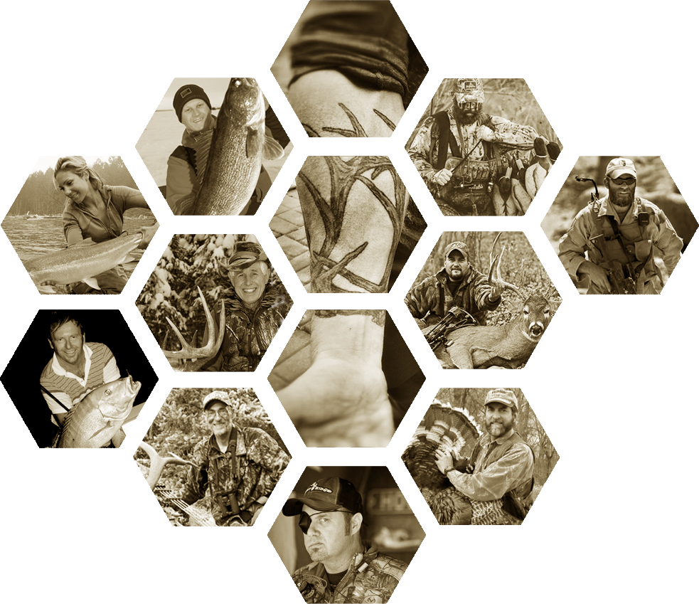
10 months...
13 Outdoor
Badasses.

Slide 10
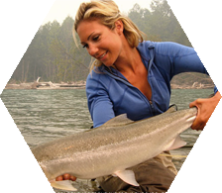
March Badass
Concept:
British Columbia flyfishing guide April Vokey has fished top freshwater and saltwater destinations around the world, but is most at home waist deep in North America's wildest salmon and steelhead rivers. A true fishing prodigy who got started as a toddler and eventually discovered fly fishing in her teens, she has dedicated her life to the pursuit of gamefish around the world on the fly. April proudly wrote and hosted her own TV series, Shorelines on The World Fishing Network, and is a badass caster with single- and two-handed rods, and a strong advocate for teaching people how to fly-fish – her driving passion in life.
April Vokey

Slide 11
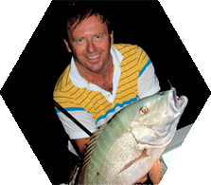
April Badass
Concept:
If you think conservation work is a safe occupation, think again. "You better sleep with one eye open" was one of the many threats Karl Wickstrom, founder of Florida Sportsman magazine received while tirelessly working to preserve Florida’s waters for sport fisherman. Wickstrom made a lot of enemies standing up to commercial fishermen, politicians and big business. From stopping the cross state barge canal to leading the charge for gamefish status for redfish, to getting the Florida saltwater fishing license passed to leading the effort to ban gill nets in state waters or most recently fighting to stop massive pollution. Whatever the issue, no matter who you are, if you are getting in the way of the sport angler, you better be prepared to deal with Karl. Doing what is right is never easy, but it’s always badass.
Karl Wickstrom

Slide 12
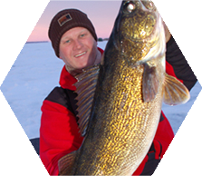
May Badass
Concept:
Legendary Great Lakes guide and multispecies expert Bret Alexander has no off season, literally. Alexander books almost as many days guiding ice anglers for trophy walleyes and whitefish as he does fishing open water for world-class smallmouth bass, pike and muskies. And that takes badass determination. Bret's love of the pursuit and relentless on-water schedule has lead to countless presentation breakthroughs, many of which are now widely employed across North Americas waters.
Bret Alexander

Slide 13
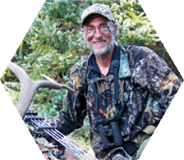
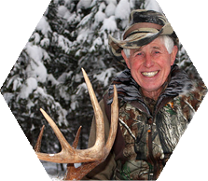
June Badass
Concept:
You don’t have to be a millennial to be badass, as bow hunting legends Dwight Schuh and Larry D. Jones have been proving for years. With more than a century of hunting experience between the two, these bowhunting pioneers literally wrote the book on backcountry hunting. They were wilderness athletes before there was such a thing and they’ve taken most every big game animal on the continent. A Vietnam vet, cancer survivor, and accomplished triathlete, Schuh hunts as hard as ever and 75-year-old Jones, who hunted through a quadruple bypass, proves time and again that he can get it done—the hard way, taking on the challenge of hunting with only a recurve bow, will and determination—the basic ingredients for being a badass… regardless of age.
Dwight Schuh
&
Larry D. Jones

Slide 14
July Badass
Concept:
When it comes to badasses, few are as hardcore as the Meyer brothers. Ranging from 25-32 these three brothers—all Montana natives—are some of the most serious DIY hunters anywhere. They start running bears in August with their own dogs and hunt through December for elk, whitetails, mule deer and cougars. This year they hunted Utah, Idaho, Montana, Washington, Oregon and Alaksa—all on public land, tagging trophy bulls, deer and bears, others only dream of. But its not just about the trophy, its about the adventure. One brother spent a month hiking the Continental Divide —camping and hunting by himself. One brother dropped him off at the trailhead; another picked him up a couple of states away. This year, the other brother spent 30 days hunting Alaska solo—all unguided for moose and caribou. The eldest, a decorated marine sniper, did three tours and after 13 IED explosions left the military and found solace through hunting. The article follows this family’s life, and love of hunting, all set against the backdrop of a Montana winter lion hunt.
The Meyer Brothers

Slide 15
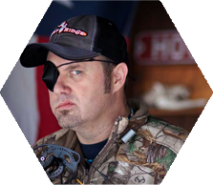
August Badass
Concept:
Next to BBQ recipes, little is more sacred in Texas than deer hunting and anything that threatens deer’s habitat is loathed. Enter the feral pig. Out of control in Texas and ranging ever northward, these invasive pests threaten every natural wildlife species in their path. Serious measures are called for to combat them and Brian “Pigman” Quaca declared war on America’s out-of-control wild hog population long before he became host of Sportsman Channel’s incredibly popular “Pigman” television series. Only a year after a horrific automobile accident nearly took his life, Brian is back on track and as determined as ever to take the battle to the hogs and make the very most of his second chance at life. His road to recover is a badass tale seen through the prism of the action-packed world of wild hog control.
Brian Pigman Quaca

Slide 16
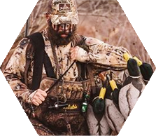
September Badass
Concept:
Waterfowlers are often thought of as hardcore hunters, and Dennis Loosier, AKA Dr. Duck, may be the hardest of the hardcore. His obsession and intuition for finding birds in hard to reach spots put him on the map, and his excellent hunt-through-the-season video takes viewers along for the entire migration. Loosier is an ideal fit for a feature in WILDFOWL’S heralded SPOTLIGHT feature, which profiles personalities of the waterfowling world, in a unique mix of industry legends as well as emerging icons who are legit core hunters… and badasses.
Dennis Loosier

Slide 17
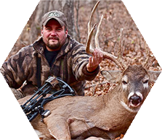
October Badass
Concept:
Arrowing a whitetail over 200 inches is a lifetime achievement—arrowing three bucks over 200 inches is simply…well badass. For Ohio bowhunter Adam Hays, killing jaw dropping bucks is all just part of his lifetime quest to hunt the world’s biggest whitetails. Despite the challenges of hunting DIY under real-world conditions, Hays consistently comes home with world-class bucks. His success is a direct result of combining deer knowledge with serious effort, extensive scouting and surgical stand placement and ultimately having the cool to make it happen at the moment of truth. Few other DIY bowhunters ever have taken their pursuit of big whitetails to such extremes — and Adam’s results prove he is badass.
Adam Hays

Slide 18
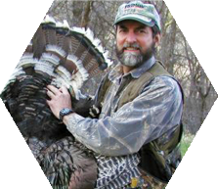
November Badass
Concept:
Changing an elk’s direction is one thing, but changing the course of an industry is something else entirely. But that’s exactly what Will Primos did. Redefining the calling category, Primos hunting calls have become the gold standard. His story is a testament to what someone can accomplish with an idea, tireless work ethic, and a stubbornness to succeed. Primos was also an early adopter of video, a media which allowed mass market reach to educate hunters on the exact scenarios and sounds that make calling work. While many know about the calls, few understand the remarkable backstory of the brand and its founder. A chance encounter in a hunting camp sparked the beginning of a revolution in calls. A rags to riches story, Primos kept working at his restaurant job even while his call sales approached the million-dollar mark. Primos built an empire that changed the hunting industry… now that’s a lasting badass legacy.
Will Primos

Slide 19
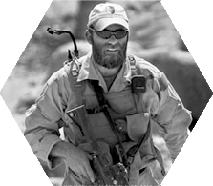
December Badass
Concept:
Tom Beckstrand, Guns & Ammo Rifle and Optics Editor, is a dedicated writer and passionate shooting sports educator. Born and raised in Wells, Nevada, Beckstrand grew up shooting bottles and cans with his father. His skill with a rifle would go on to serve him well in the military from West Point to Afghanistan and Iraq, where he led both Special Forces and counter-terrorism sniper teams.
After his military career, Beckstrand started writing for shooting publications, eventually landing at Guns & Ammo magazine. At the time, there was limited coverage of optics in books and publications, and Beckstrand stepped in to help fill the gap. An ever-evolving area of shooting sports technology, optics became a passion for Beckstrand. Known for his insatiable curiosity, Beckstrand sought to explore optics technology from every angle for his readers.
Capt. Tom Beckstrand

Slide 20
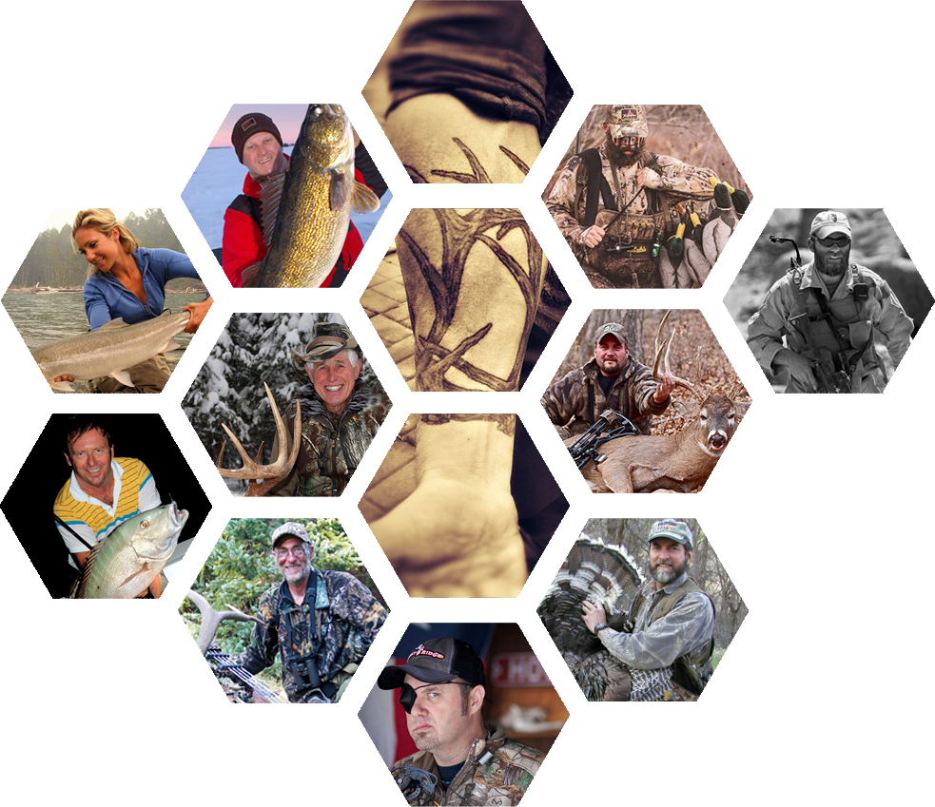
Meyer Brothers Larry, Curly & Moe
Bret Alexander
Dr. Duck Dennis Loosier
April Vokey
Capt. Tom Beckstrand
Karl Wickstrom
Adam Hays
Dwight Schuh & Larry D. Jones
Will Primos
Brian “Pig Man” Quaca

