Slide 1
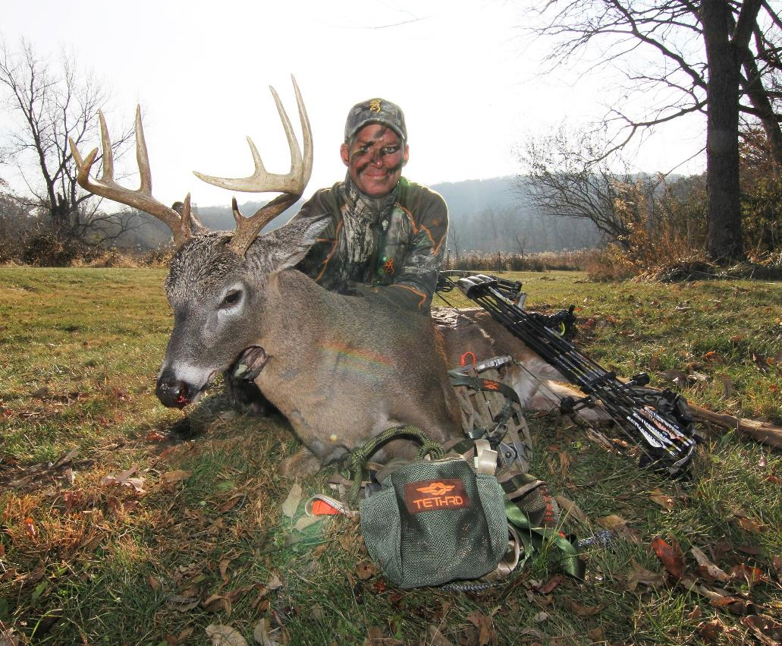
SADDLE HUNTING SUCCESS
How and what you need to get started
by MIKE CARNEY
Bowhunter Magazine & TV

Slide 2
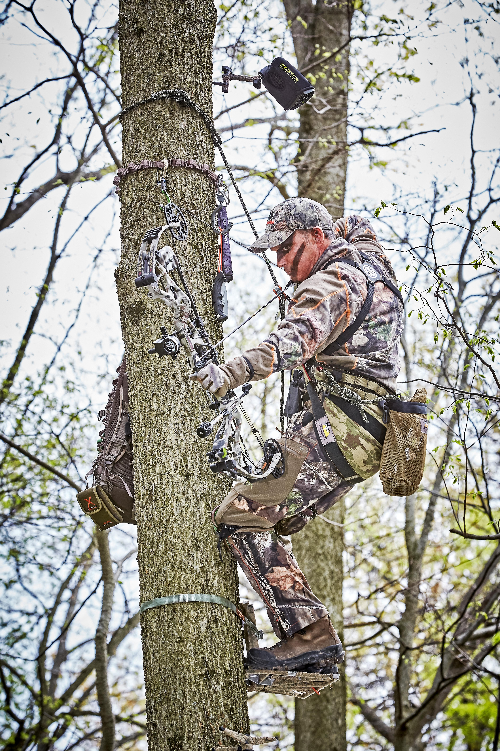
What It Is
Saddle hunting is an elevated, mobile hunting system that is not only the most adaptable method to trees of all shapes and configurations, it’s also the lightest, least bulky and most quiet portable system you can employ. To add its effectiveness and appeal – it’s also incredibly comfortable and exceptionally lethal.
Modern saddle hunting, while born out of the desire to have an extremely portable and adaptable system, is not just for public land hang-and-hunt scenarios. If you lease or own land, saddle hunting offers an extremely economical and cost-effective option to clear and pre-hang multiple trees with low-cost climbing sticks or steps – and hunt every setup out of one lightweight, portable saddle you wear or take with you to the tree.
So, saddle hunting is an exceptionally versatile method, which can shine brightest in the most challenging scenarios.

Slide 3
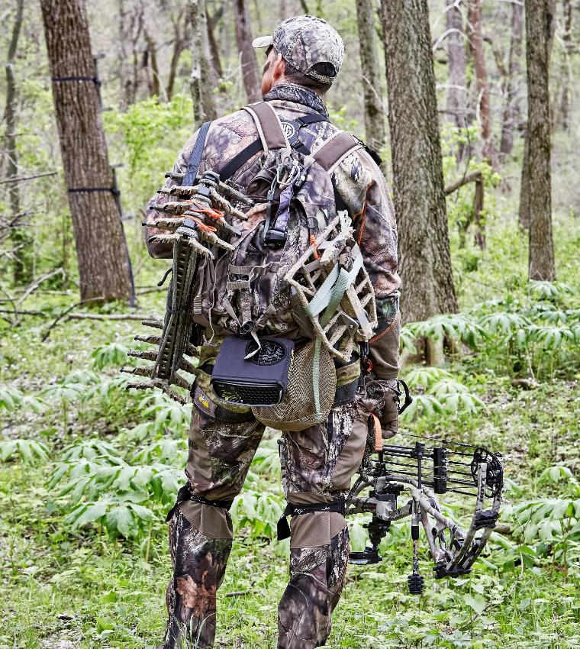
Lightweight
Versatility
Compared to any other elevated method, a tree saddle, climbing method and platform are the least bulky, most quiet and lightest option you can employ.
A saddle and ropes, climbing sticks and platform can weigh as little as 12 pounds, which includes the equivalent of your full-body harness. A hang on stand and sticks, or a climber, with a full body harness in either case, is not only materially heavier, but also a lot noisier and bulkier to haul through the bush.

Slide 4
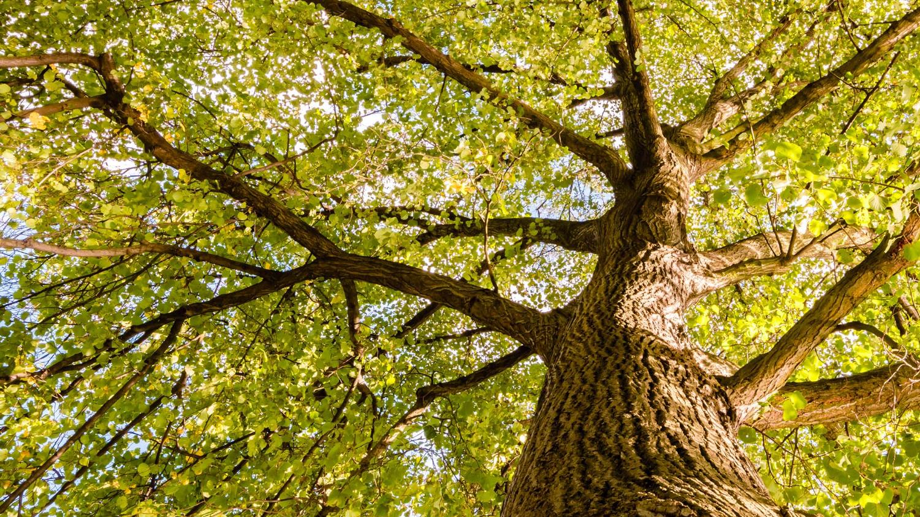
MOST ACCOMMODATING
The tree saddle system is also the most accommodating of the widest variety of trees – from skinny, to branchy to leaning or split. With a saddle you can pick the best tree to kill a buck from, as opposed to the best tree you can use your climber or hang-on in.
And, just so we cover it off at the beginning, saddle hunting isn’t binary, you can still use all your other elevated methods as well if you like. Saddle hunting just puts one more extremely effective option in your quiver of tools.

Slide 5
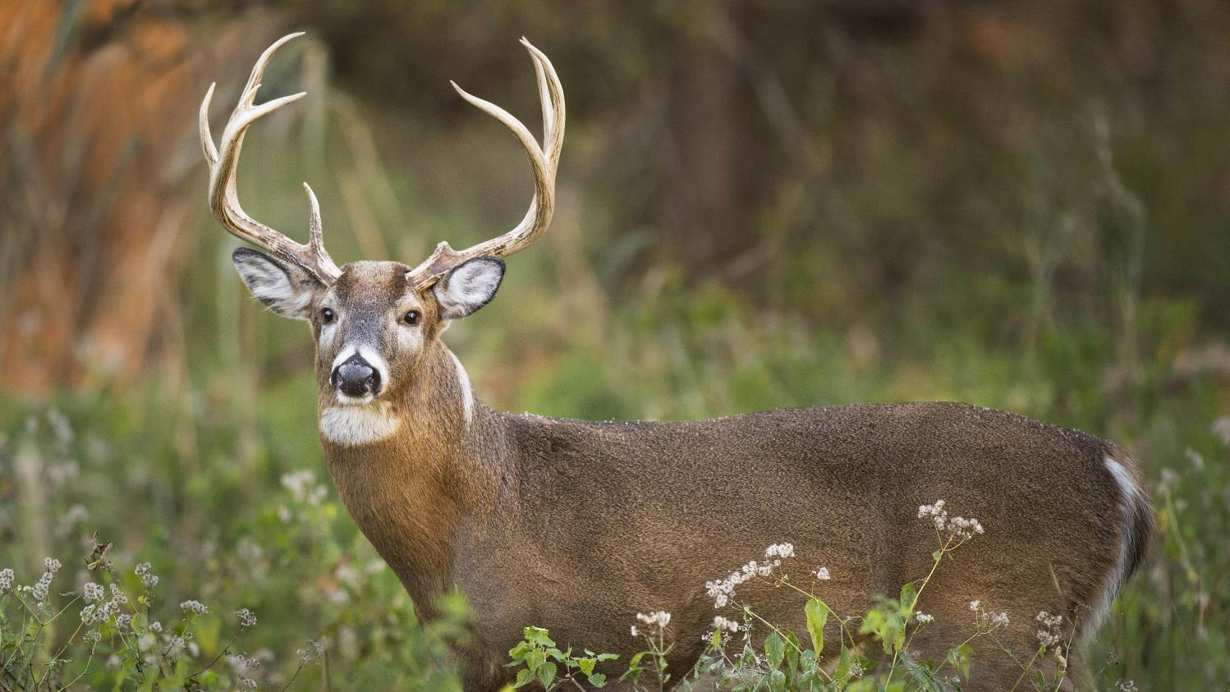
Total Surprise
If you’ve been deer hunting for any amount of time you’ve no doubt heard the old saying: First sit – best hunt. And for good reason, it’s usually true, as you surprise your quarry who has never encountered you – or tell-tale signs of you in his woods before.
With an ultra-quiet, lightweight saddle, every sit can be a first hunt – without the bulk, weight and noise of a hang-on, or the limiting tree selection of a climber.

Slide 6
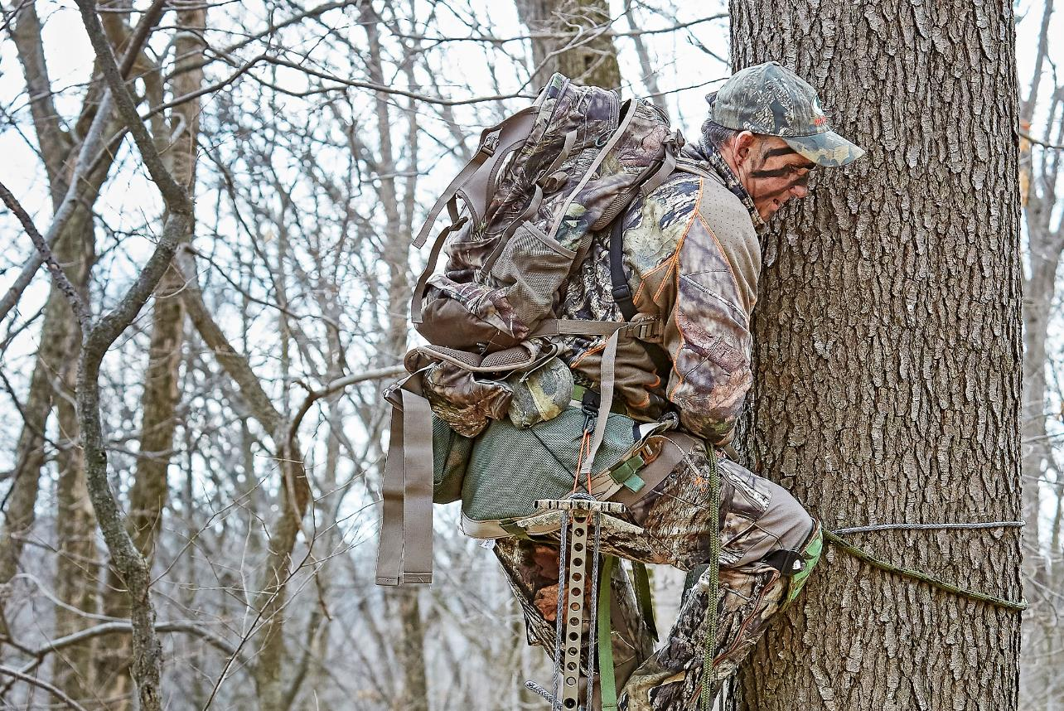
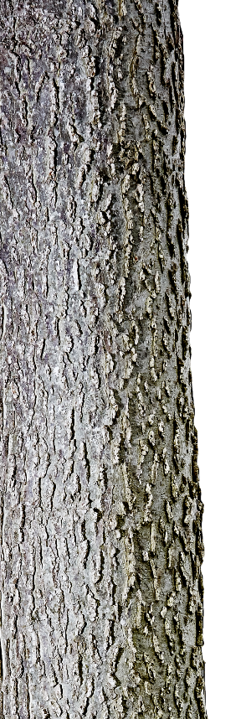
Flexibility
A typical climbing stand needs a tree with a minimum diameter of at least 6 inches and a max diameter of no more than 20, without any limbs below the height you want to reach. You might find the perfect tree, in the perfect location to kill your dream buck, but your climber forces you to choose a less ideal tree because of lower limbs – or the tree is too big around.
With a saddle, it’s simply not an issue. Not only can I climb super skinny trees if needed, I can utilize a much bigger tree than a climber can accommodate. You could use a hang-on stand in some of these scenarios, but you need a good straight section of tree to hang it, it’s bulkier to carry and noisier than a saddle to hump through the bush.

Slide 7
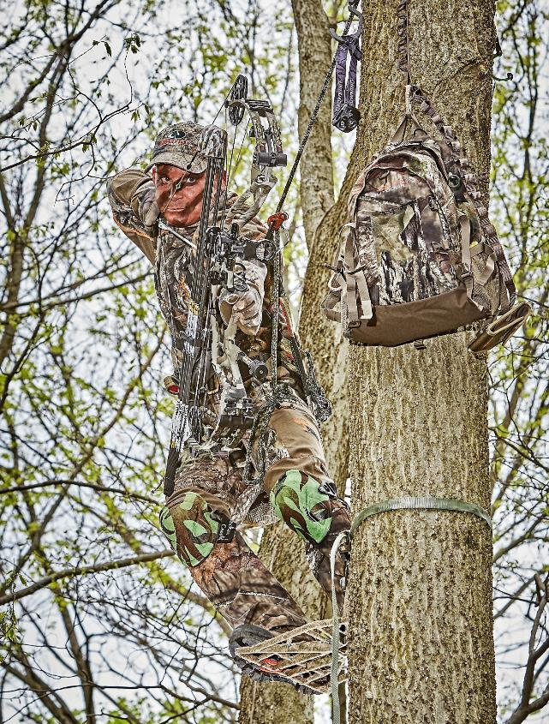
Concealment
One of the other great advantages of a tree saddle is the way it conceals your location. Because you hunt facing toward the tree, you set up with the tree trunk between you and where you expect deer to come from. As an animal approaches, you can utilize the trunk to hide behind – until just the right moment to draw and shoot.
Learning to shoot a vertical bow from a saddle takes some practice, but it’s easily learned and maintained in a few dedicated sessions per week. Shooting a gun from a saddle is incredibly easy, because as you face the tree, you can use the trunk to brace your hold, steady your aim and make you rock solid for the shot.

Slide 8
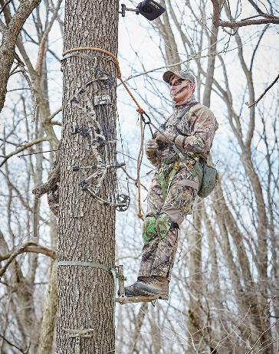
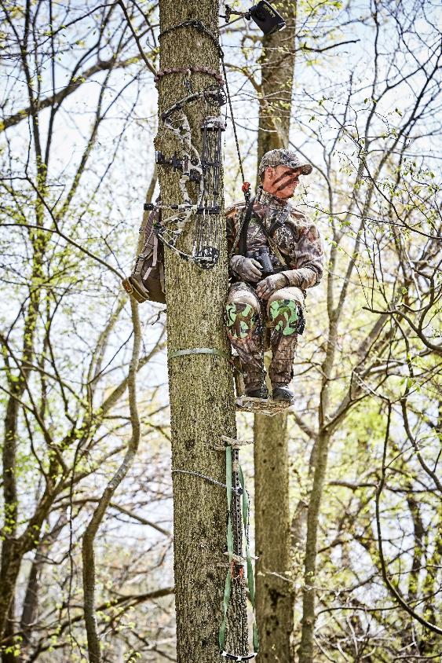
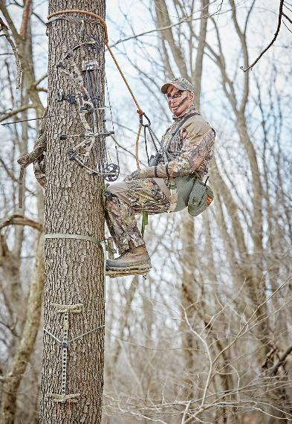
Comfort
One other big question that always comes up is how comfortable. Think of a saddle as a hammock for your butt. They’re that comfortable. Plus, there are lots of little set-up tweaks that you can make on a saddle to ensure it fits your personal build and preferred hunting position, including adding an easily adjustable back rest.
I do lots of all-day sits during the rut, and I find a saddle, because I lean most of the day, to be exceptionally comfortable as opposed to standing flat on my feet in my hang-on or climber.
In a saddle I can sit facing the tree, hang beside it, lean back in it, lean on a tree behind me, or stand. In a climber or hang-on, I can only sit or stand.

Slide 9
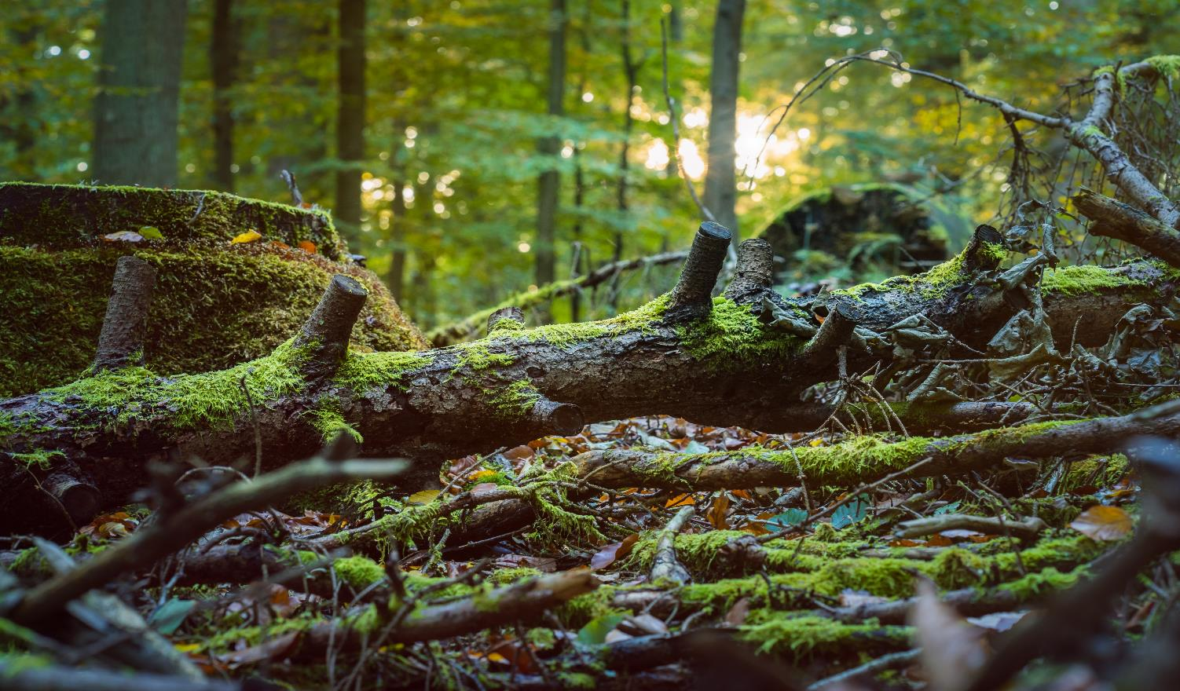
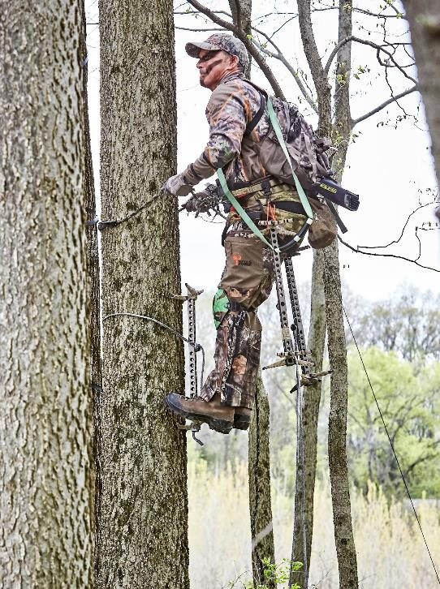
Safety
As far as safety is concerned, saddle hunting is as safe, and arguably safer, than any other elevated climbing method, because you’re always attached to the tree with at least one fall prevention tool: either a lineman’s belt, a tree tether or both.
And unlike a full body safety harness, a saddle isn’t made to catch a fall from height and withstand the subsequent shock, it’s design actually prevents you from falling in the first place – as you’re always under tension in the system (more on this to come).

Slide 10
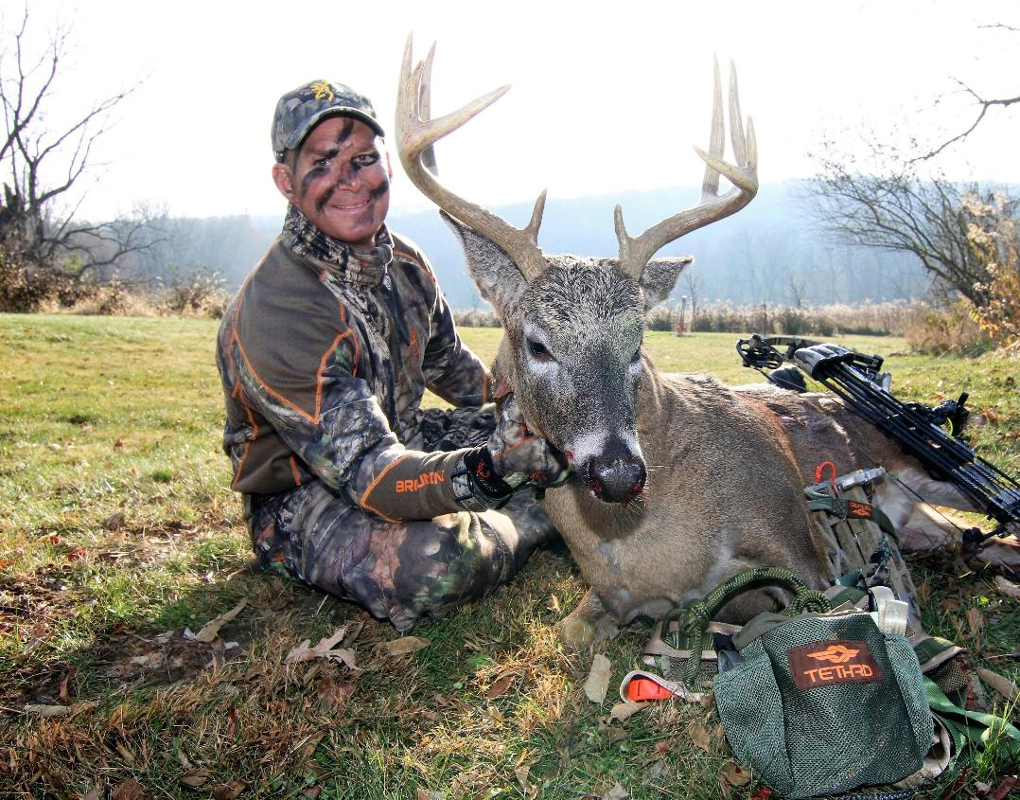
Fun and Enjoyment
Developing your own saddle system, your climbing method, your gear list – and then effectively hunting with it, is downright fun, not to mention extremely gratifying when you put it all together and score on a good buck – in a tree you never could have previously set up in.
And don’t be fooled, this system isn’t just for the cross fit gang out there. I know lots of 50 and 60-year old’s using saddles all season. In fact, some of these more advanced hunters are also among the biggest saddle advocates, like Dave Thoms or the Godfather of saddle hunting – John Eberhart.

Slide 11
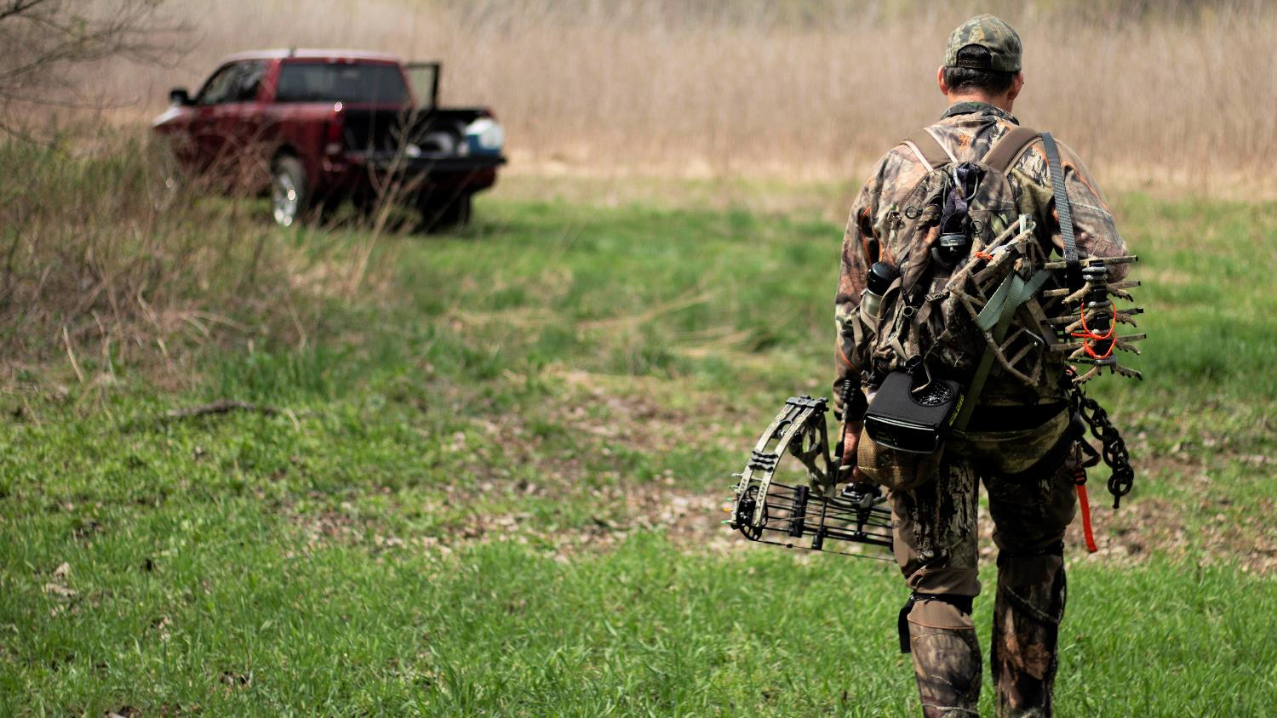
ESSENTIAL GEAR
TO START SADDLE HUNTING

Slide 12
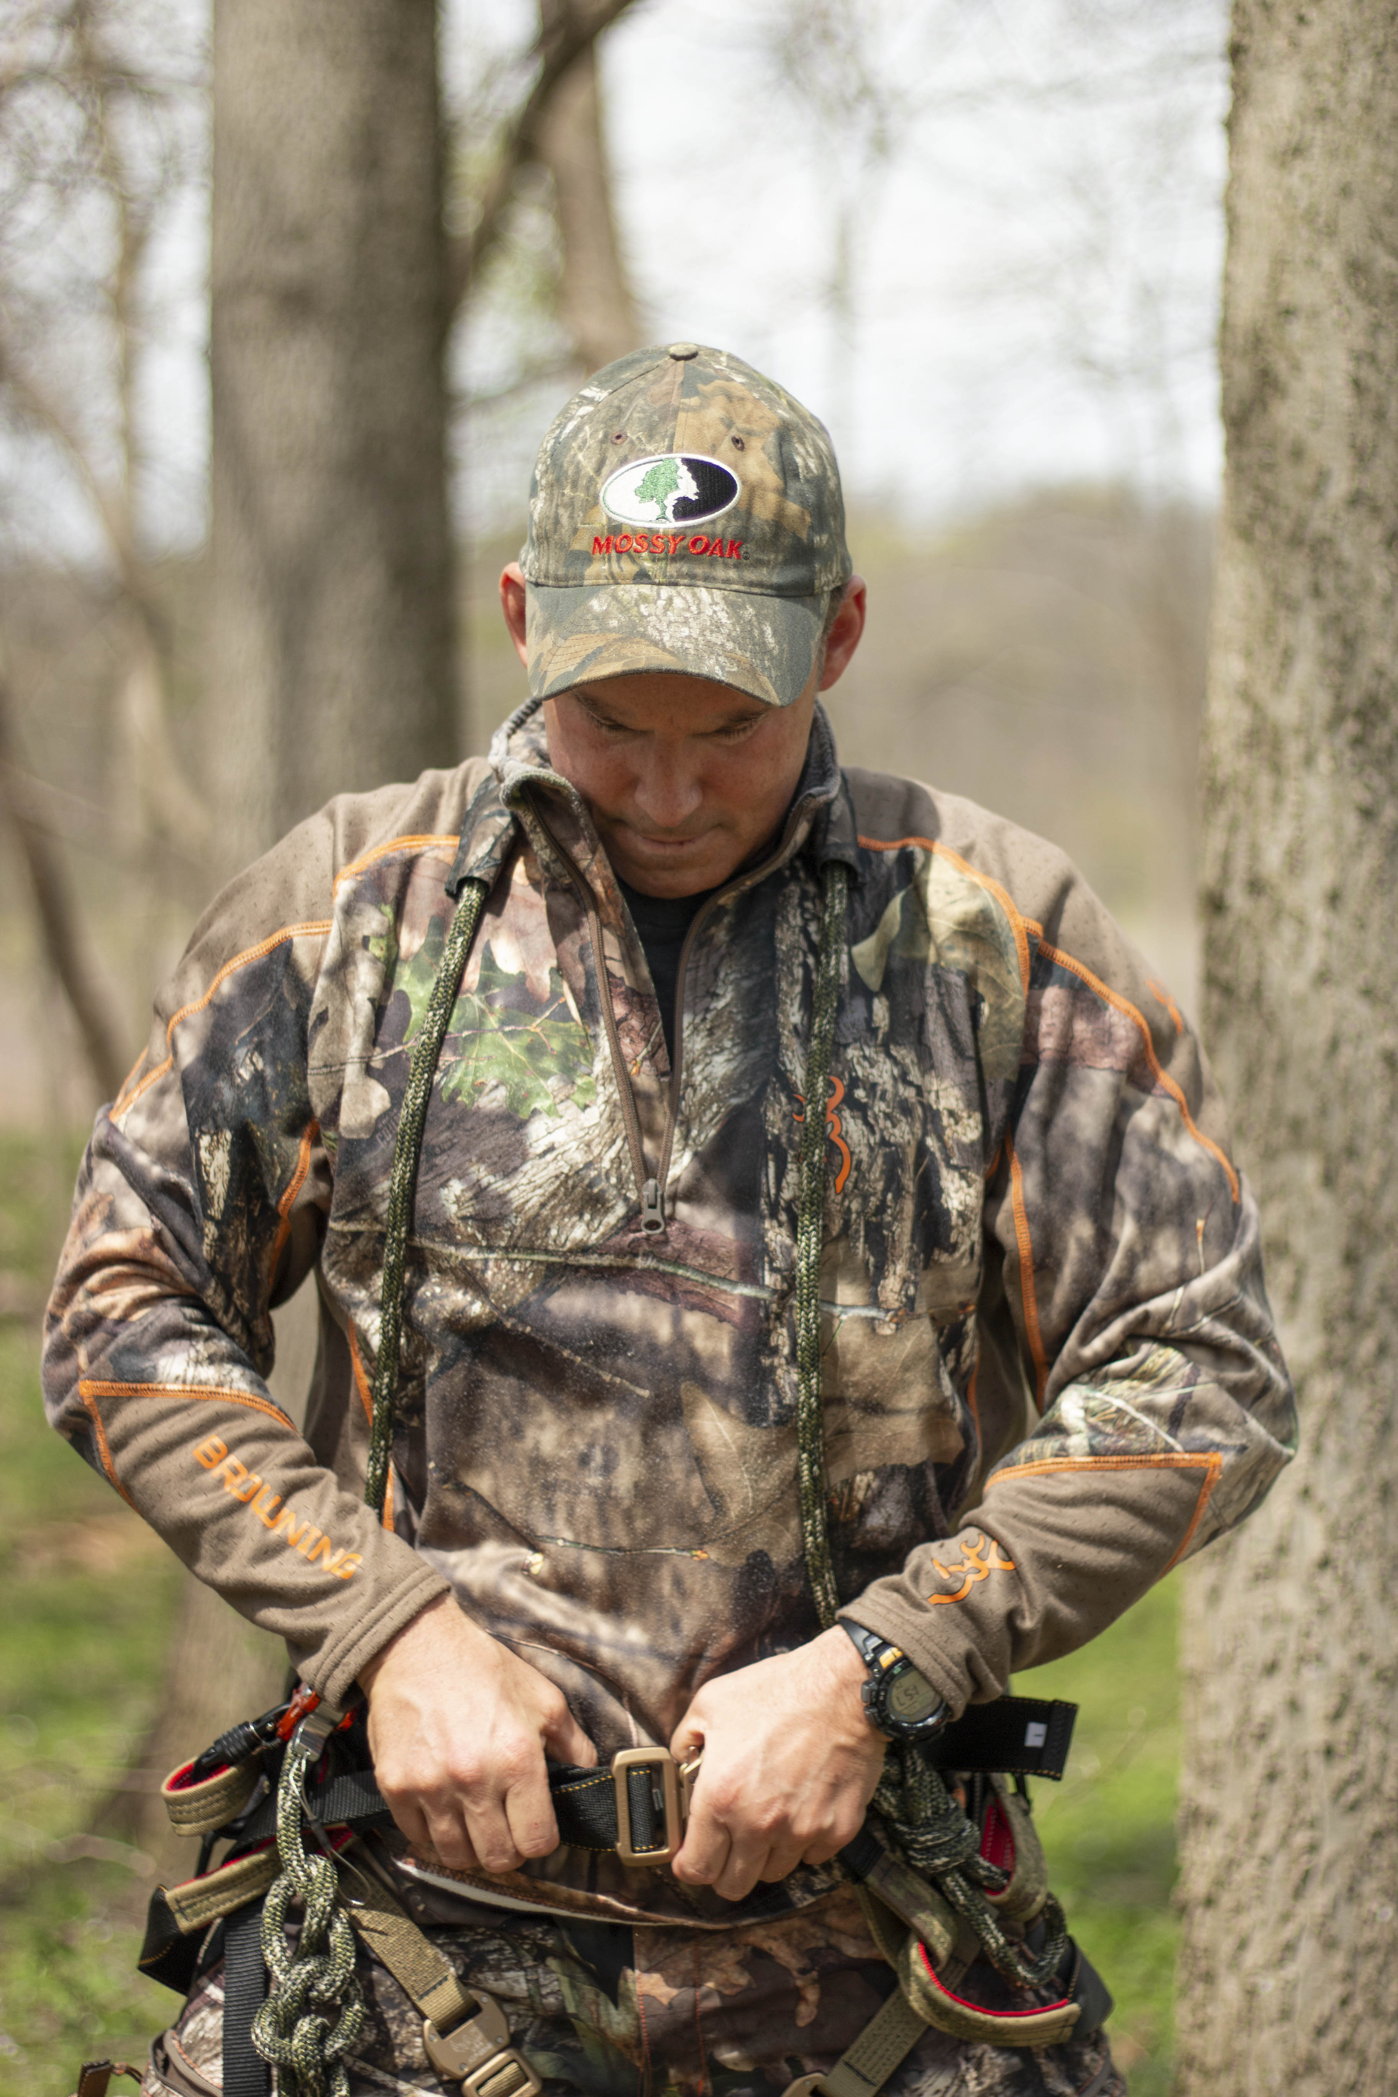
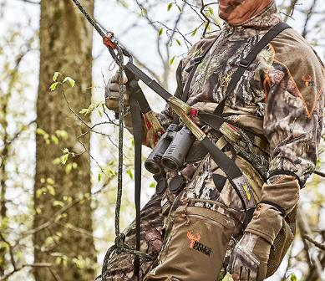
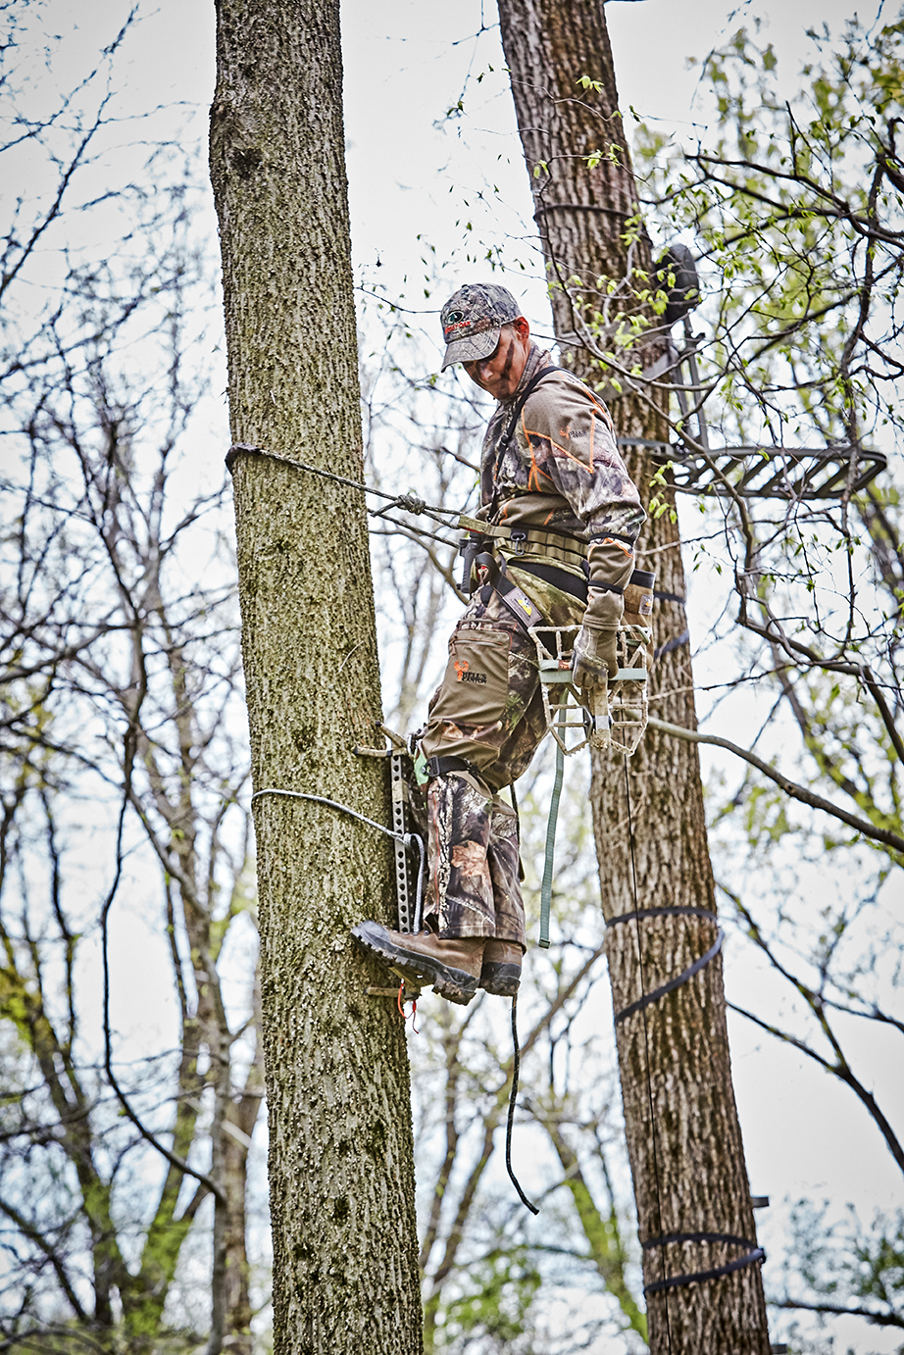
The
RIGHT
stuff
The Saddle System
Consists of:
1. A tree saddle.
2. A bridge, typically a rope or climbing-rated strap,
which ideally is adjustable, and is attached to specific webbing loops on the saddle.
3. A lineman’s belt for climbing, which connects to other dedicated side loops on your saddle.
4. An adjustable tree tether, which is girth-hitched around the tree at approximately head height.
You will also need an auxiliary lineman’s belt for when you need to navigate around tree limbs during your climb, which we’ll cover later.

Slide 13
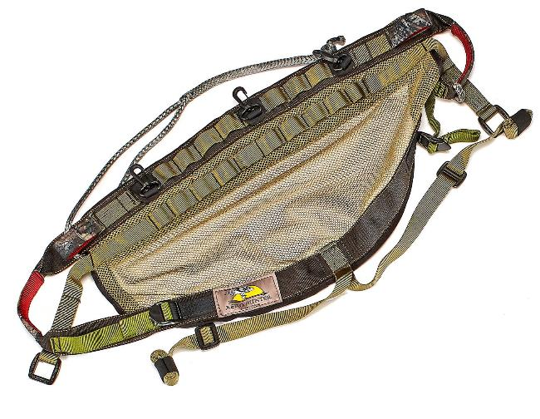
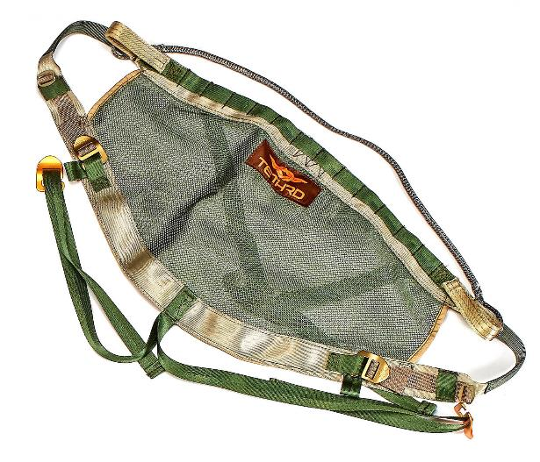

1
SADDLE SYSTEM
Most saddles come in different sizes depending on your waist measurement, and their overall comfort is largely a function of their design. Some are made from individual panels of material, like Cordura, sewn together to form a seat; some have flexing panels, which open up under your weight; some are a single piece of flexible, mil-spec breathable mesh.
Whichever the style, many components factor in on overall saddle comfort, from the frame straps of the saddle that help disperse pressure, to how your bridge pulls up in its loops to cup the hamstrings and hips. If you want to know what the general consensus among users is of a particular model, check the saddlehunter.com forum.

Slide 14
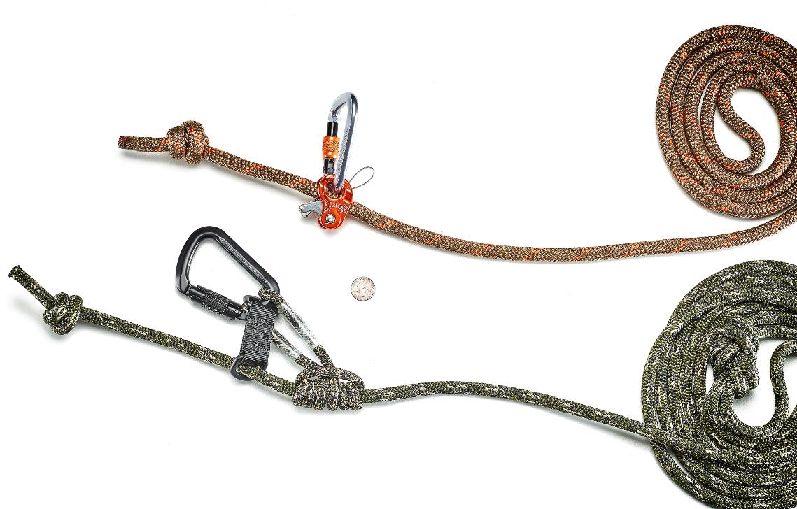
*
For an auxiliary lineman’s, like when you have to tie off above a limb, you can use your tree tether with a spare climbing-rated carabiner, you can make a lightweight one out of Amsteel, or even a spare rope from a full body harness you have. In either case, make sure that you always bring it and use it, so you are always connected to the tree
during your climb – up and down the tree.
1
2
LINEMAN’S ROPE
For your lineman’s belt, I recommend a small-eyed prefabbed model, with a minimum 8-foot length, and most come with a prussic loop and a carabiner. I like to augment this setup with a prussic tender or mechanical ascender, like a Ropeman One, which allows you to make easy one-handed adjustments on the fly. Not only is it way more convenient, it’s also safer because you can keep your other hand on your sticks, steps or the tree. Your lineman’s belt should be used from the minute you start to climb, and not taken off until you fully and safely transition into your tree tether and bridge.

Slide 15
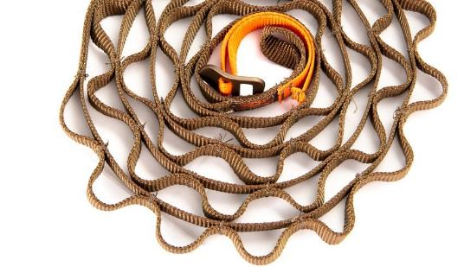
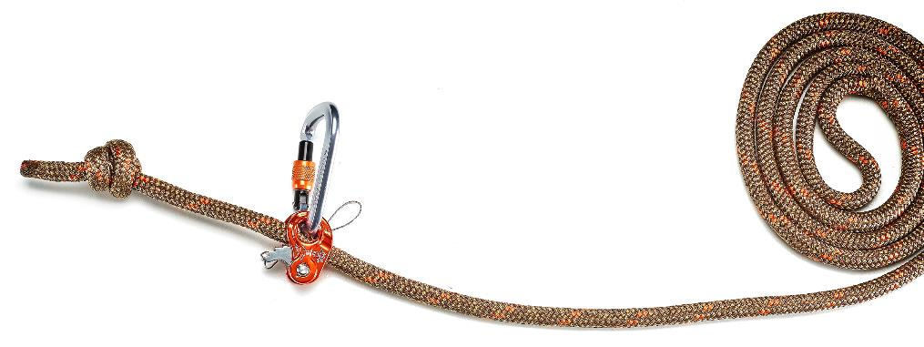
1
2
3
TREE TETHER
Next you need a tree tether, which is what will hold you attached to the tree at height. This rope is typically eight-feet long, has a large open eye for girth hitching around the tree, and ideally is slightly different in color or some way labeled to distinguish it from your lineman’s rope. At height in the tree, this rope is typically set up right around head height as a starting point.
After you are clipped in at your hunting height, you will also need a gear hanger for your pack, bow and accessories, and the best one I’ve used is the Tethrd HYS Strap. It’s lightweight, convenient and is a great gear organizing option, for everything you need handy, like a rangefinder, rattle bag, calls or whatever.

Slide 16
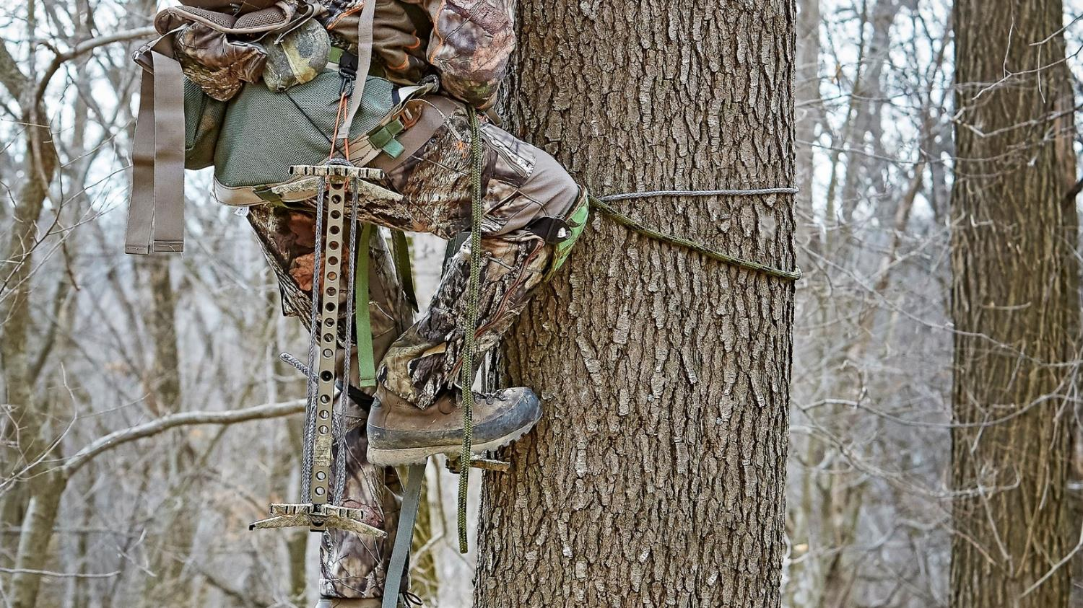
CLIMBING
STICKS & AIDERS

Slide 17
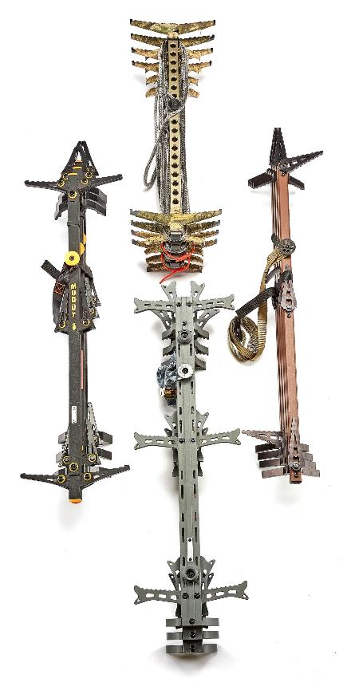
Climbing Method
We have to safely – and comfortably – climb the tree, and the primary portable climbing methods are:
Sectional tree sticks, usually three or four separate sticks
Individual steps like Wild Edge, Tree Hopper Strap On Steps, Bullman, Squirrel or Cranford steps
Climbing bolts and a drill, like the Tree Hopper system
Climbing spurs or even more advanced methods like one-sticking

Slide 18
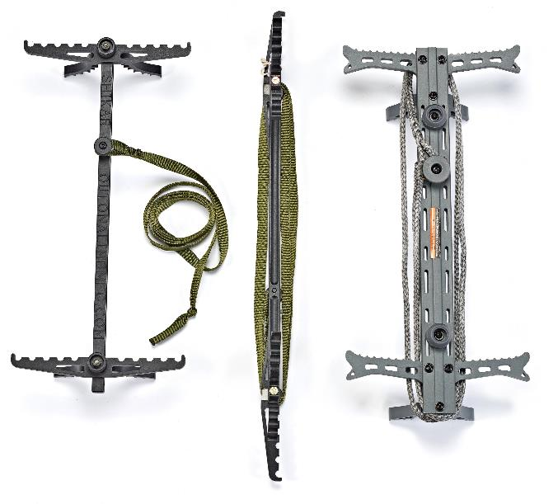
Sticks
Let’s start with the most popular climbing tools, sectional climbing sticks. Sticks are popular because:
They can be very lightweight
Are relatively easy to pack
Are easy to affix to the tree
Can be hung with a wide variety of materials from buckle-less Amsteel ropes to daisy chain straps
Accommodate a wide variety of tree diameters
Deliver a good height-to-weight ratio
Have a great safety record
You only need to hang three or four of them to reach a reasonable hunting height
Sticks are also very climbing-aider friendly, which are unique tools we’ll cover shortly

Slide 19
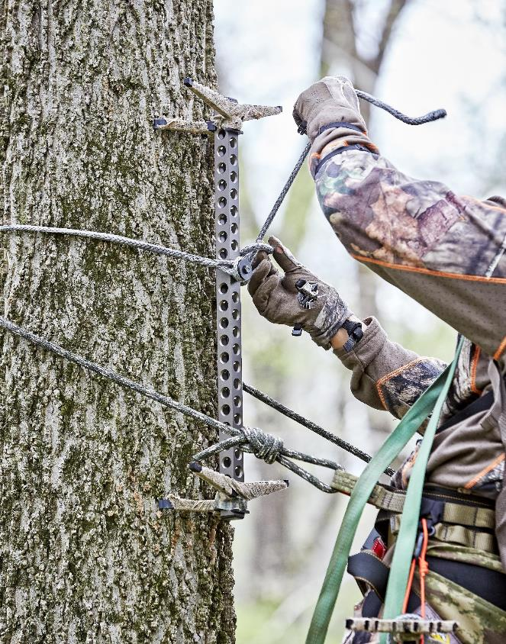
For saddle hunting, most sticks are either two- or three-rungs per stick, with either a dual-step or a switchable, left/right one-step design. I typically use a two-rung, dual-step stick, because they are lighter, shorter overall to pack, and I can rest my full weight with both feet on a rung when needed.
Let’s quickly talk rung spacing. All things being equal, the larger the distance between stick rungs, the higher you can climb in a tree.

Slide 20
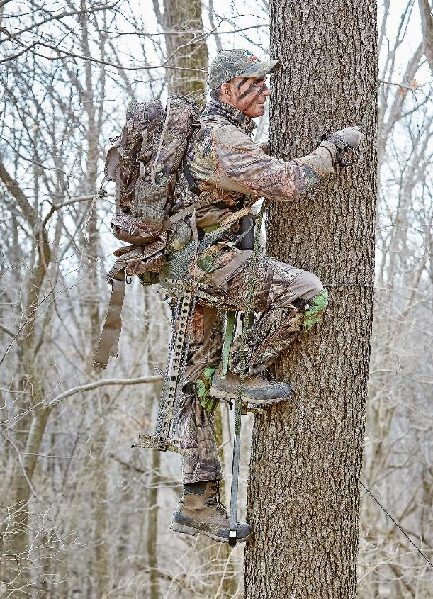
In early season, even for a 5’-10” guy like me, I can use a stick with a rung distance of 22” safely, without a lot of stretching. As the season advances and I’m using more clothes, like bibs or heavy pants, it’s much more comfortable, and safe, to have a rung spacing of 17” or 18” so I don’t have to stretch like crazy. I sacrifice some overall climbing height with shorter spaced rungs, but I can always carry one more stick or utilize an affordable and super lightweight climbing aider.

Slide 21
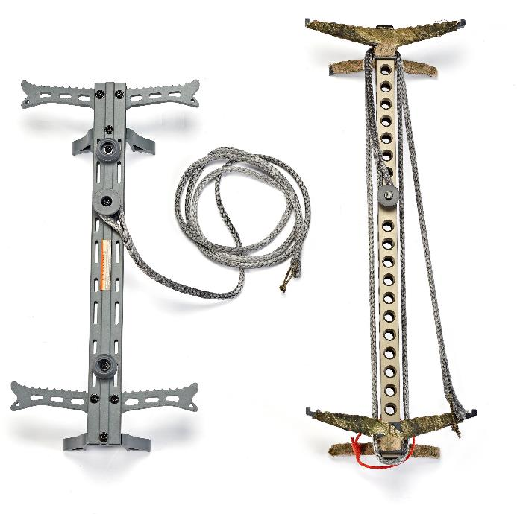
Sticks to Fit
Many of the top end, mobile stick designs today come in multiple rung lengths. The lightweight and super-packable Out On A Limb Shikar’s, for example, come in 17”, 20” or 22”, and you can even order them in in single or dual-step configurations, with multiple options for attaching them to the tree!
Beast Gear sticks come in 18” or 22” step lengths. And even the super-affordable Hawk Heliums can now be had in the original 14” three-rung, dual-folding-step design, or a new overall shorter two-rung design with 17” step spacing, which makes them a lot lighter.
Lone Wolf Custom Gear is offering a premium fold-flat, two-rung, single switchable step stick, and a two-rung, fixed dual-step stick, both of which can be outfitted with their integral coated-wire aider option that is ingenious.

Slide 22
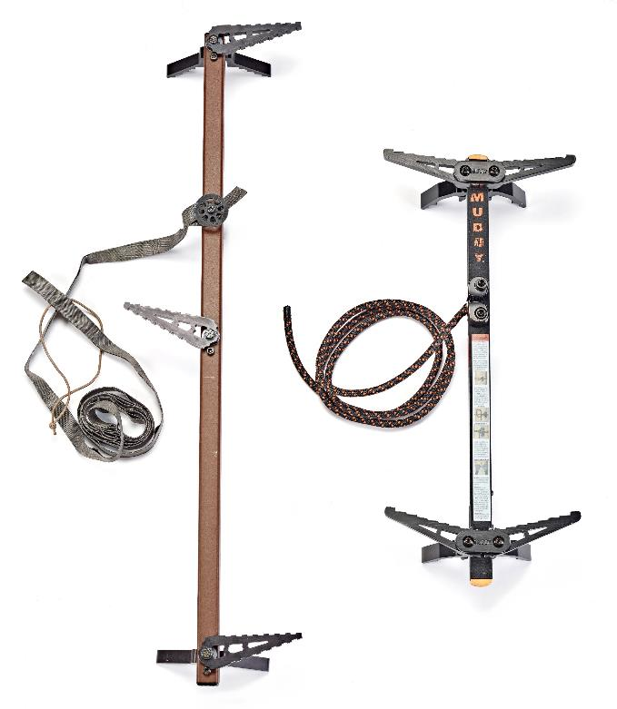
Other popular options include…
Muddy Pro Sticks, the venerable three-rung, single step per side original Lone Wolf sticks, and the similar but heavier XOP sticks.
I evaluate sticks on five major criteria:
How heavy they are
How easy to hang
How securely they set on the tree
How easy they pack and carry
How high I can get with four of them
The height-to-weight ratio is a primary goal, but sticks that provide safe, confident climbing is what we’re looking for.
In any case, all can be used with a simple carry-as-you-climb aider – or dedicated aider that hangs below each stick.

Slide 23
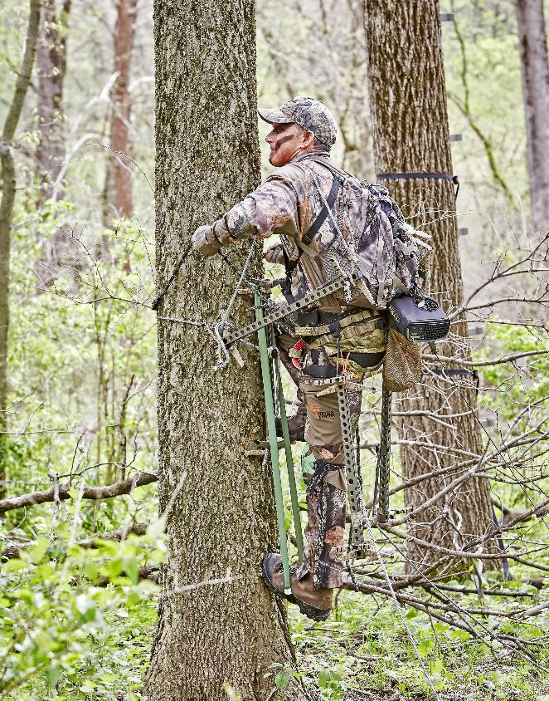
AIDERS
GAIN HEIGHT – SHED WEIGHT
There are a variety of climbing aiders you can employ with sticks – and even some with individual steps – that help you gain extra height with a minimum of added weight. The simplest, most efficient and failsafe are, in my opinion, the carry-as-you-climb aider, and the fixed aider.

Slide 24
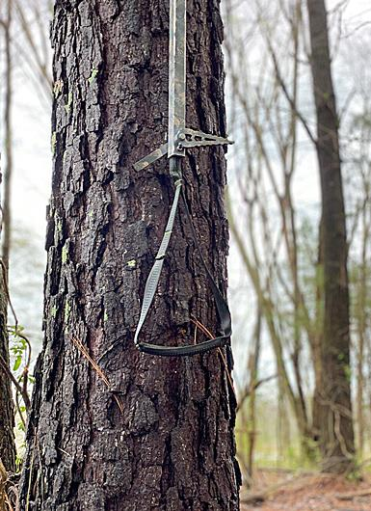
A “fixed” aider…
is simply a loop of rope or climbing-rated tubular webbing that is tied on the bottom of each of your sticks, and essentially adds one more step to each stick. If you have a two-rung stick with 20-inch spacing, you tie on a piece of webbing that hangs 20-inches below your first step. So, instead of having a stick that gets you 40-inches high, the aider version gets you 60.
That may not sound like a big difference, but when you do the math, four sticks with an aider is the equivalent to using six sticks in vertical height – but for a fraction of the weight.
Comparatively, it’s the difference between climbing 13.3 feet for four sticks – or 20 feet with the aiders, when set up with equidistant spacing. That’s a 50% increase in height, which is a lot of concealment difference, like after the leaves drop or in thinner trees without cover.

Slide 25
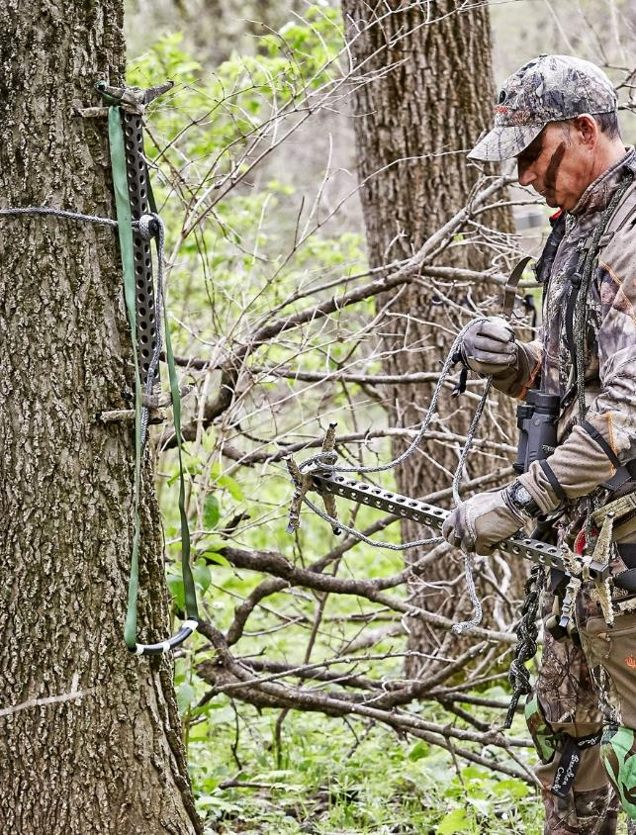
A “carry-as-you-climb” aider is one that you typically hang over the top rung of the stick, then remove it and put over a shoulder after you place your feet on the bottom rung, then climb, hang your next stick and repeat to the top. For the climb down you just use it in reverse.
This is the style aider I built to work with my 22” Beast Gear sticks. It’s 44” in overall length. This makes each stick climb 66” and four of them gets me 264” or 22 feet high – if needed. And this is without stretching or spreading out between sticks, every step up or down is approximately 22”, so I can climb confidently and quietly.

Slide 26
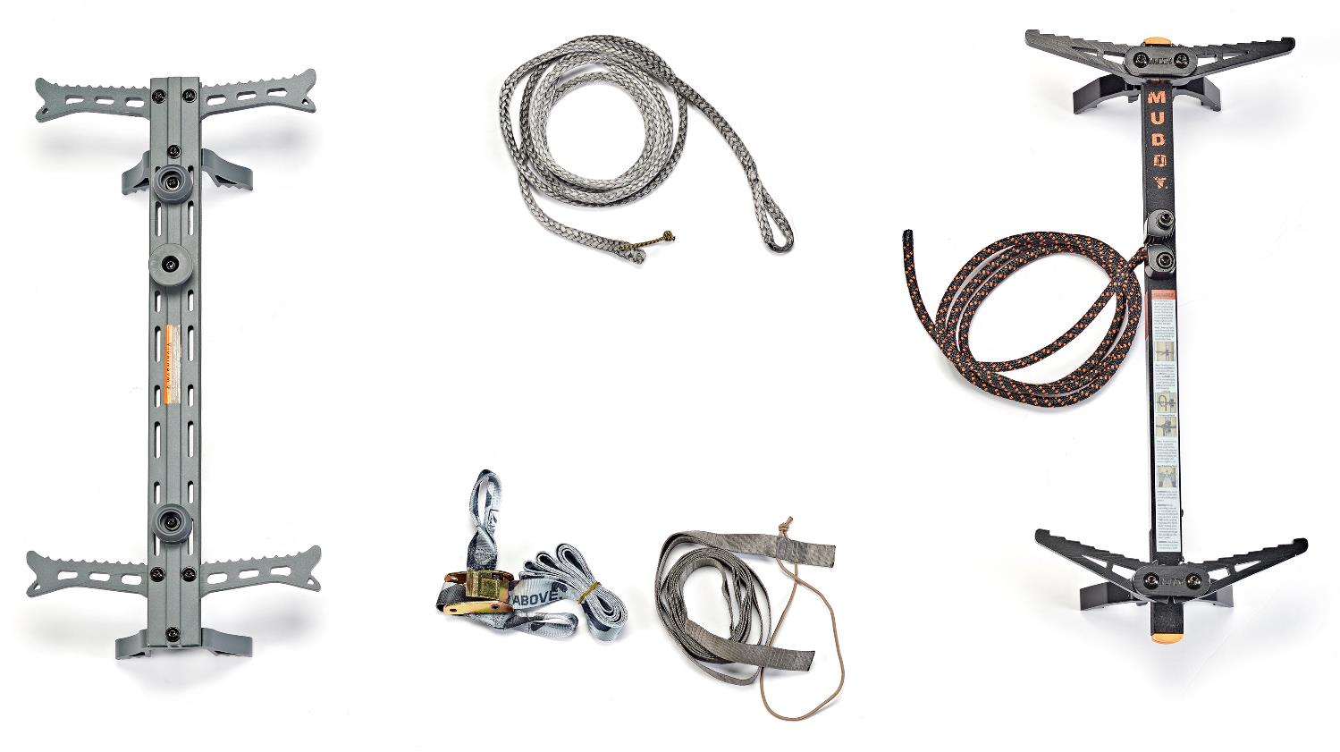
MODDING
YOUR CLIMB

Slide 27
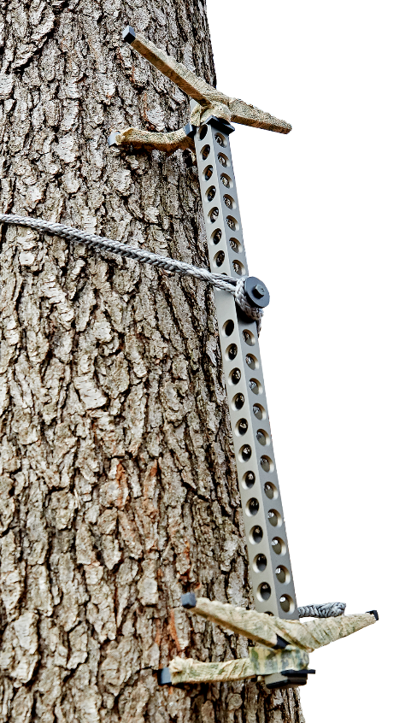
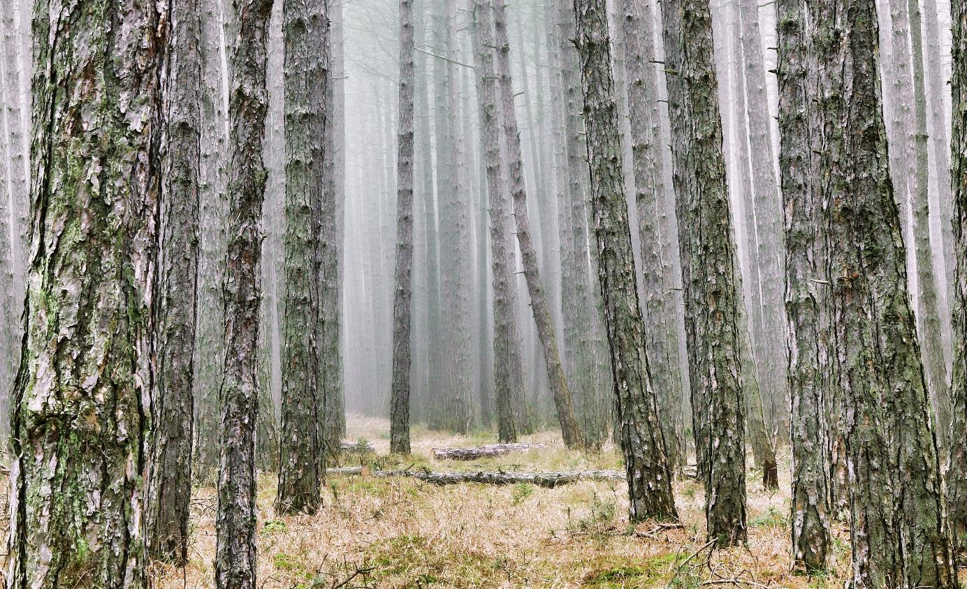
AMSTEEL
CLIMBING ROPE - DAISY CHAINS
& more…
Super-tough, crazy-light, quiet-to-carry and deploy tree strap options can significantly improve your stick experience. I prefer hand-tied ¼” Amsteel ropes 9-foot long that are ridiculously light, easy to pack and strong enough to lift a Jeep.
Hand-tied 1/8” Amsteel daisy chain or Tethrd Versastraps are another elegant, lightweight and silent option, as are 7-8mm static climbing rope and the simple strap-and-wrap options like those from LWCG and OOL Shikar sticks.

Slide 28
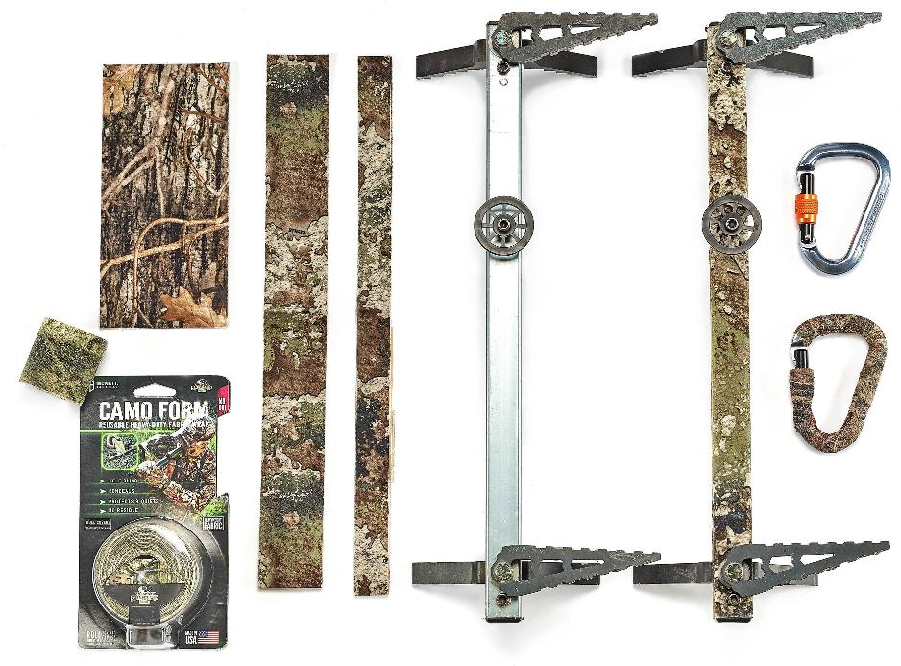
Stealth+Silence+Camo=Awesome
Need something camouflaged, silenced and sound deadened?
Stealth Strips and Camo Form removable tape are indispensable.
Stealth Strips come pre-cut for matching popular stick sizes and Camo Form flexible tape can wrap around odd shaped metal items like carabiners, buckles and more.

Slide 29
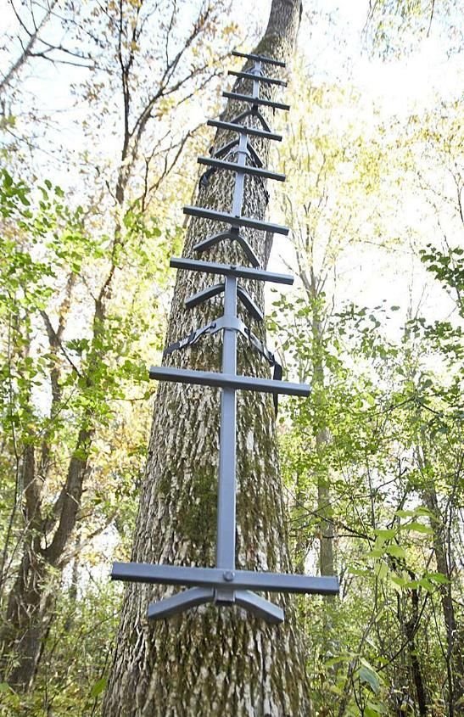
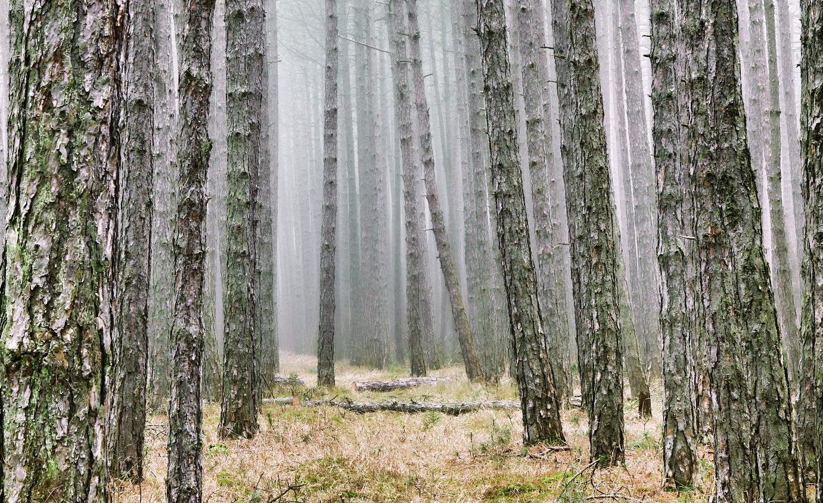
PRE-HANG/PRE-CLEAN
SETUPS
Keep in mind if you hunt a state or public area that you can leave sticks set up on, or you have access to private land, there are lots of economical choices in heavier steel sticks, so you can pre-hang, trim and clean multiple trees. Then all you do is pack-in or wear your saddle to the tree.
For private landowners, this option is far cheaper than buying dozens of hang-on stands.

Slide 30
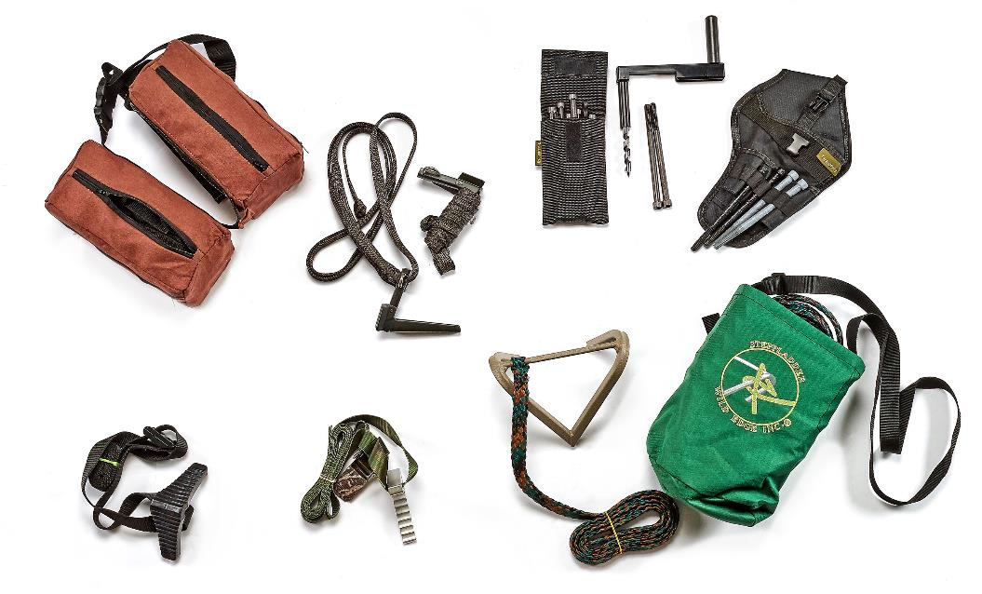
Steps, Bolts
& More
The most common alternate method
to climbing sticks are individual steps,
like the venerable screw-in type for private land,
and for public the newer strap-on
type like Bullman, Tree Hopper,
Squirrel and the super-popular
Wild Edge Step. Some of these,
like the Wild Edge Step, can even be used
with aiders, so eight-to-ten steps can get you as high as 18-20 ft.

Slide 31
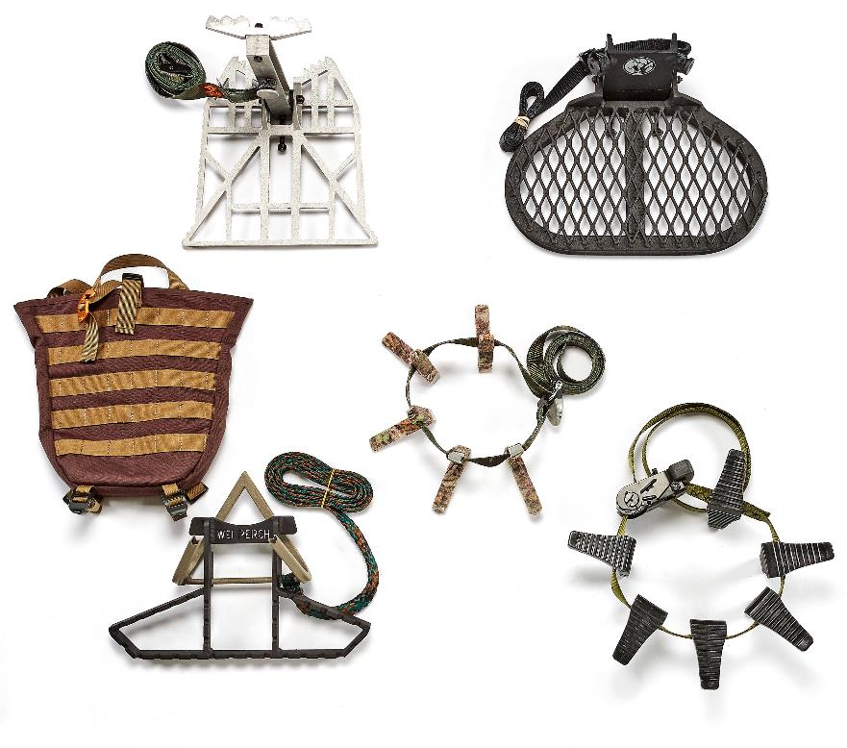
A Foothold
at Height
Once you reach your target height, you need someplace to put your feet. The two most popular options are a platform and a ring-of-steps.
A platform is essentially like the base of a hang-on stand, just scaled down in both size and weight.
A ring-of-steps is a set of steps threaded onto a buckle or ratchet strap that you spread around the tree trunk, and you use them to “walk” around the tree to position yourself for a shot.

Slide 32
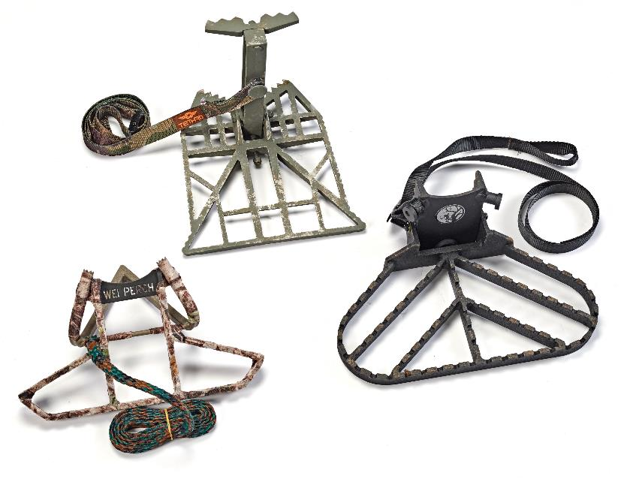
Lightweight,
Versatile,
Comfortable.
The best platforms, like climbing sticks, are
lightweight, easy to securely mount to the tree
in the dark, and don’t budge under your shifting
weight – like when you’re trying to set up for a shot.
Tethrd’s Predator, Out On A Limb’s Podium and Ridge Runner,
the Wild Edge Perch and even the big Kuhnert’s Ambush from
Lone Wolf Custom Gear are prime examples. Last season I hunted
a lot from a Tethrd Predator, and its combination of secure, easy
set-up, plus it’s shape, side-wings and light weight made it my
go-to platform. I’ll be testing out some other new options this spring.

Slide 33
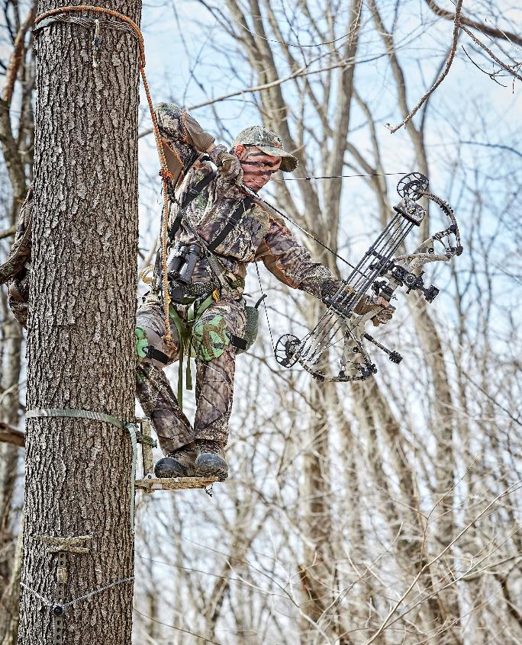
MAKING THE
SHOT
There is always a lot of talk about saddle hunting providing 360-degrees of shooting around the tree, and while this can be true, like anything else in life that is a step-driven procedure -- it takes practice to execute properly.
The best way to instill the saddle shot process, is to practice it realistically from your saddle and platform. To start, this means just a few feet off the ground, or maybe one-stick high, so you can work through all the different foot and body positions required with different animal approach angles.

Slide 34
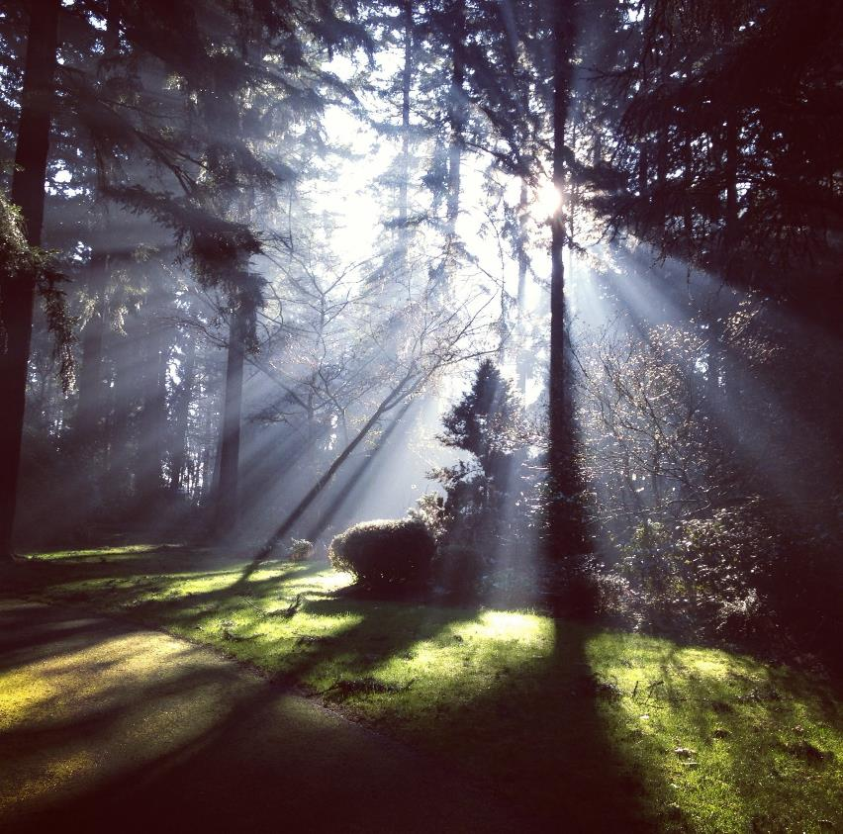
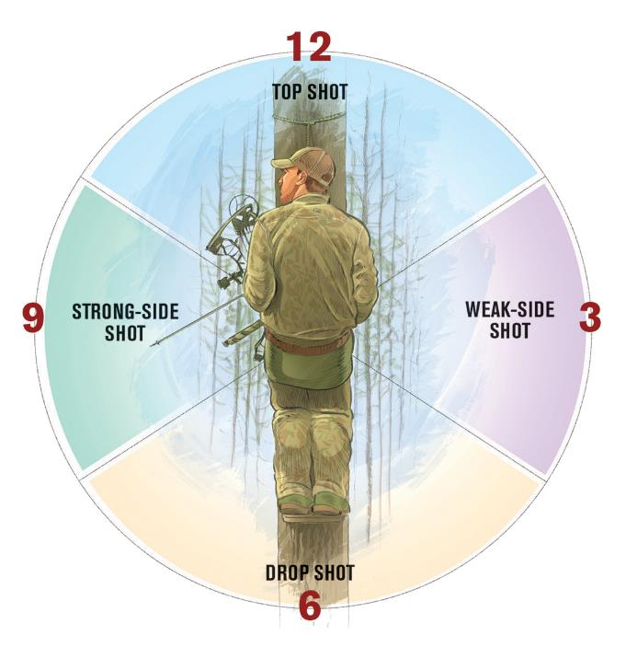
RUNNING
THE CLOCK
For illustrative purposes, the shooting shot clock starts with you facing the tree, in the 12:00 position; directly behind you is 6:00, leaving your immediate right as 3:00 and your immediate left as 9:00.

Slide 35
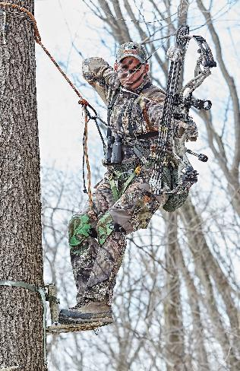
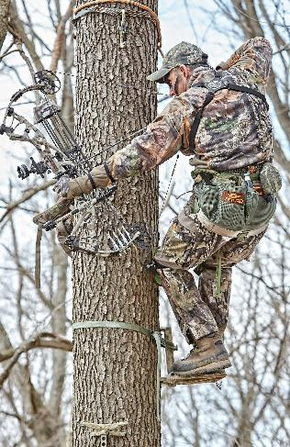
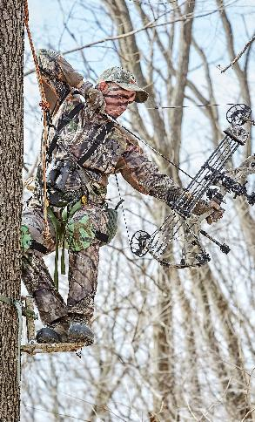
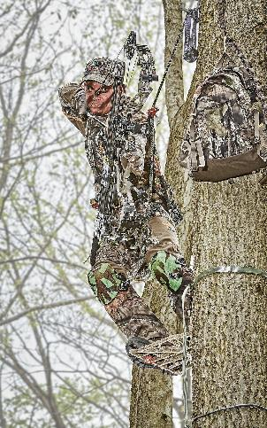
The Four SHOT Angles
STRONG SIDE SHOT
TOP SHOT
DROP SHOT
WEAK SIDE SHOT

Slide 36
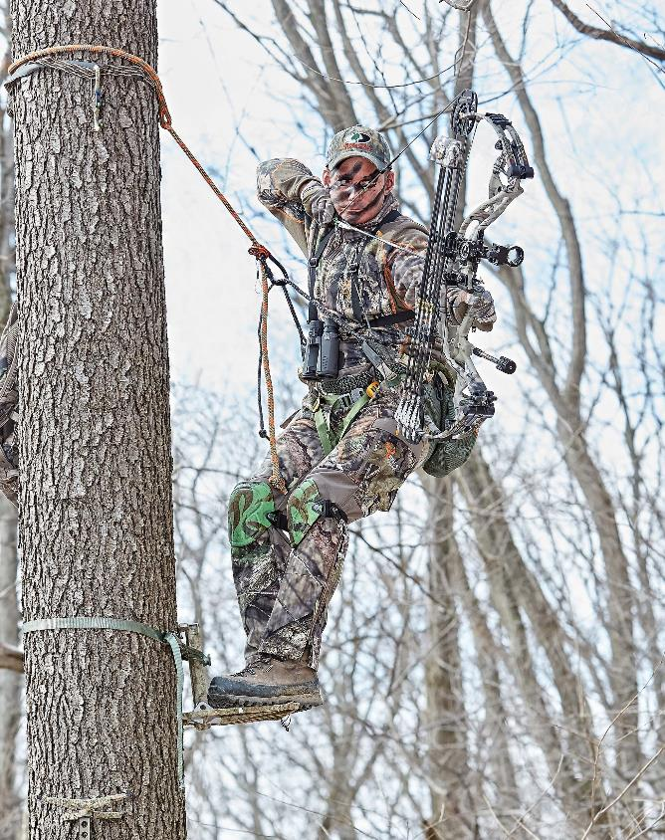

STRONG SIDE
SHOT
The easiest and most natural shot with a bow for a right hander is the strong-side shot, which covers everything from approximately 7:00 to 10:30-ish. This is an easy window to cover, and you should set up in the tree so you put yourself in position to have this area be where you expect most deer to come from.

Slide 37

TOP
SHOT
The top-side shot is directly in front of the tree from approximately 10:30 to 2:00, you simply slide over to the left, with your right foot typically pushing off and braced on the left side of the platform, with your left knee braced on the side of the tree.

Slide 38

DROP
SHOT
The drop shot, which is in the 5:00 to 7:00 position is the second easiest shot window to master, and one of the most fun shots for an archer. Its’ simple matter of leaning back and twisting to your left, letting your tree tether to full support your weight, bracing your right foot on the top of your platform or the tree trunk, and lining up your good T-form.

Slide 39

WEAK SIDE
SHOT
The weak-side, 2:00 to 4:30ish window is the shot that requires the most movement to execute and is the most problematic. There are a couple ways to execute it.
While facing the tree you can raise your bow above your tether and bridge, while pirouetting clockwise on the platform; this is my least favorite option.
My preferred method is to take my right arm and shoulder, slide it under my tether, the slowly slide my feet around in little steps so I am full supported by the tether and can easily maintain good, fully-supported form. This turns a difficult scenario into a strong, confident shot experience.

Slide 40

Tying it All Together:
Developing YOUR gear list and climbing procedure.
Now is the perfect time to order your saddle, sticks and associated gear. First, many saddles and the best sticks were on back order most of last year. You want to ensure you have plenty of time to choose your ideal gear mix, get it ordered and on the way so you can familiarize yourself with all aspects of it – and most importantly – develop your own specific climbing procedure.
This is best done during the warmer months where you can practice your complete climb up, gear setup at height, and the climb back down, so you know what feels comfortable, consistent and safe. It’s going to take multiple trips up and down to completely familiarize yourself, so you can confidently setup in darkness. You can also practice all the various shot executions, so when that dream buck appears, you execute flawlessly at the moment of truth.

Slide 41

Putting it
To The Test
This is also the stage when you will be getting in what my friend Greg Godfrey from G2 Outdoors and Tethrd calls “saddle shape”.
It’s another way of saying that this system isn’t like climbing up a ladder stand at your friend’s – you have to make this system and the associated gear you choose, work best for you and your particular setup, bow, crossbow or gun.

Slide 42

Other ESSENTIAL Gear
Small grappling hook
Hero Clips
Aero Hunter Molly Accessory clips
Ropeman 1
Spare Carabiners
Nite Ize S-Hooks, Rubber Wire Wraps
Doyle’s Huntin’ Hoist
Tethrd HYS Strap
Knee Pads
Stealth Strips & Camo Form Tape

Slide 43



Learn More…
To see some of the gear I use, how I organize it and how I go about climbing up and down the tree, see the Tree Saddle Demo Climb with Aider Use on the Bowhunter TV YouTube page, and go to Bowhunter.com and Bowhuntingmag.com to read specific saddle hunting articles we have posted.
Also see saddlehunter.com forum, G2 Outdoors, Flinginairos, Hunt Urban, Tethrd Nation YouTube channels.
This presentation is
Copyrighted ©2020 Mike Carney
All Rights Reserved.

Slide 44










Slide 45

THANK YOU
For Attending
The Iowa Deer Classic
This presentation is
Copyrighted ©2020 Mike Carney
All Rights Reserved.

