Slide 1
THE Multimedia Success Guide For New Kayak Anglers
BUYING, OUTFITTING, HOW-To, WHERE-TO RESOURCE GUIDE

Slide 2
2022 MULTIMEDIA GROWTH & EDUCATION INITIATIVE
Outdoor Sportsman Group’s KAYAK FISHING FUN multimedia initiative will launch Season 2 in April of 2022. Our goal with this year’s program is to maintain the demand created in 2021 of new buyers, and to educate and teach new kayak and canoe owners how to get the most out of their hull investment through smart and creative rigging and outfitting. After helping consumers find their perfect kayak, we will be educating all the recent buyers of kayaks and canoes on how to operate and rig their boats for optimal performance, safety and success on the water. To inform this new audience of prospects, we will be utilizing every media asset we own.
A Lot of future sales have been pulled forward into 2021 – this comprehensive program will help maintain growth of new participants in 2022 and beyond, and we look forward to helping you grow your brand’s market share with it!
Please contact your Outdoor Sportsman Group representative to review options for inclusion and participation.

Slide 3
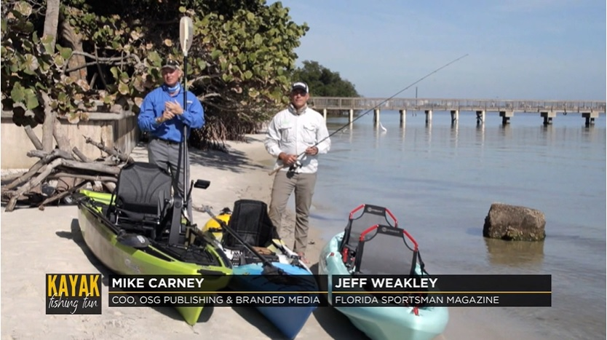
2022 | OSG KAYAK FISHING MULTIMEDIA GROWTH INITIATIVE
TELEVISION
Outdoor Channel, Sportsman Channel and World Fishing Network linear TV platforms will be running a dedicated one-hour TV special on the fun and thrill of Kayak Fishing premiering mid-April 2022 at 7 pm Eastern.
The TV Special will include how to choose a kayak for your specific fishing needs, kayak reviews, canoe applications, cool rigging ideas, transportation, storage and best practices for safe operation, including safety gear. After the premiere we will re-air the special 12 more times across the three networks for a total of 15 unique airings available in 60+ million households per airing!
A Success Guide For New Kayak Anglers
Please contact your Outdoor Sportsman Group representative to review options for inclusion and participation.

Slide 4
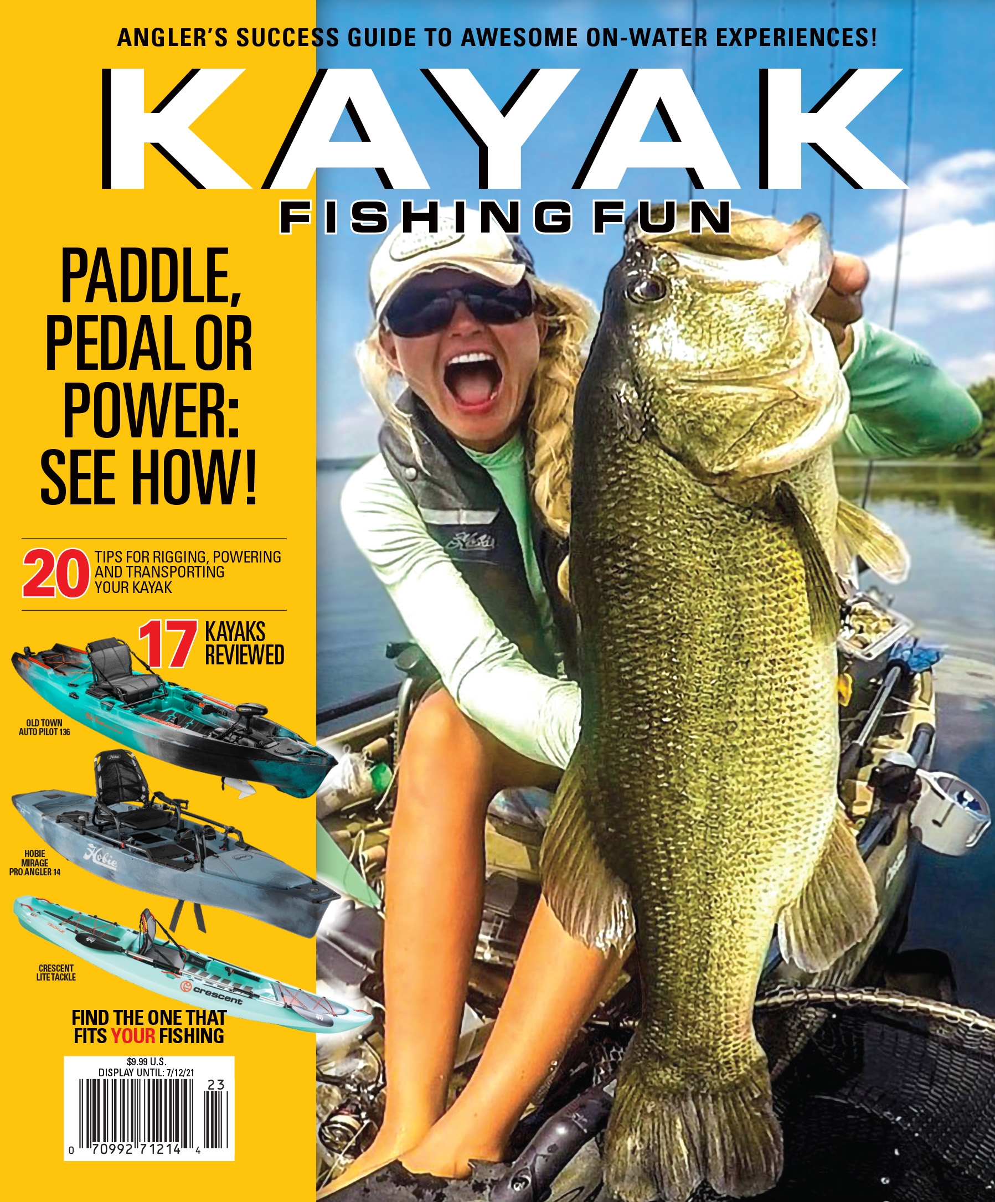
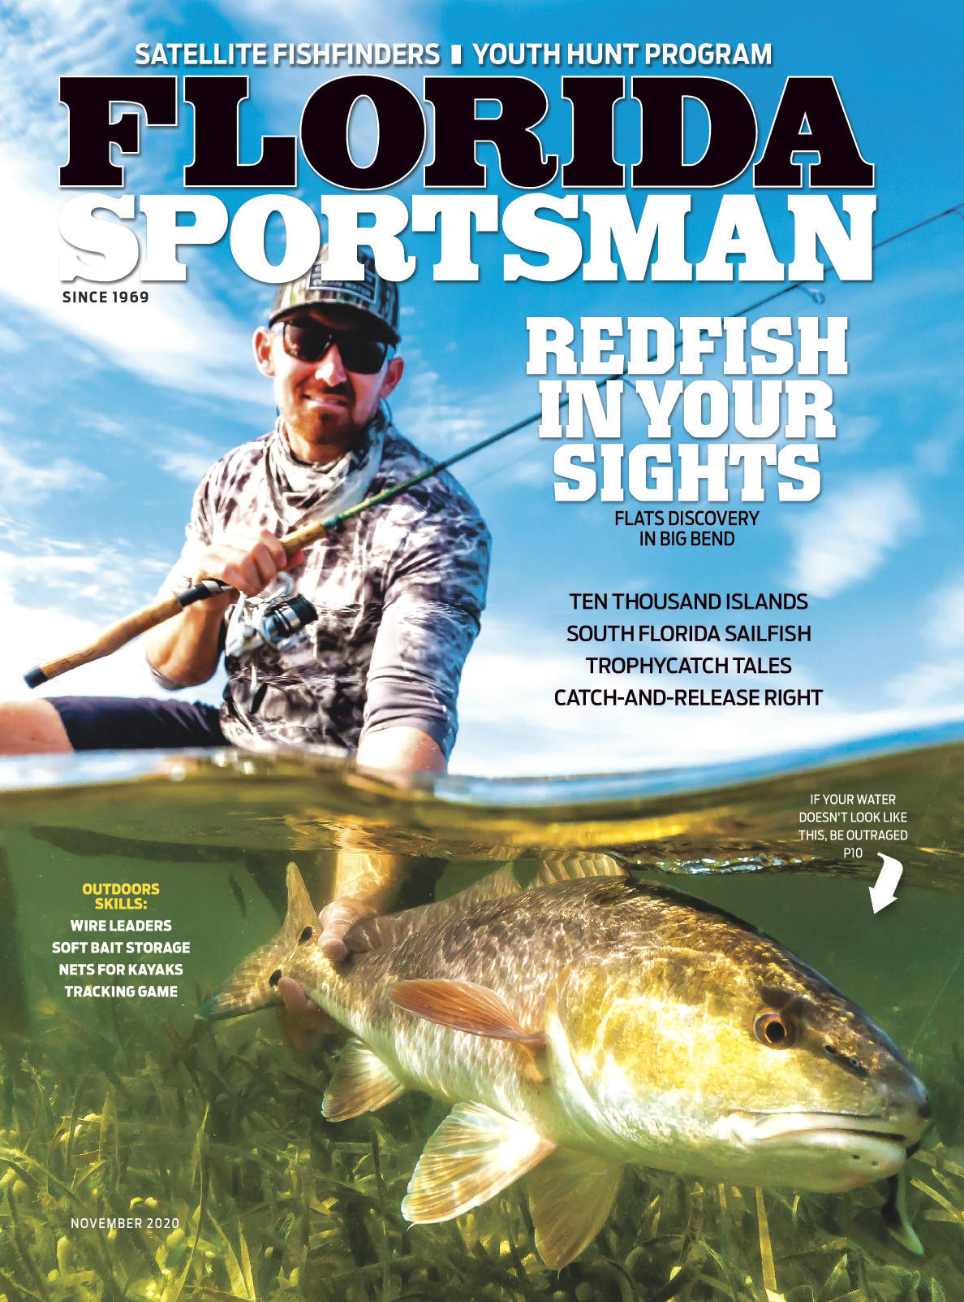
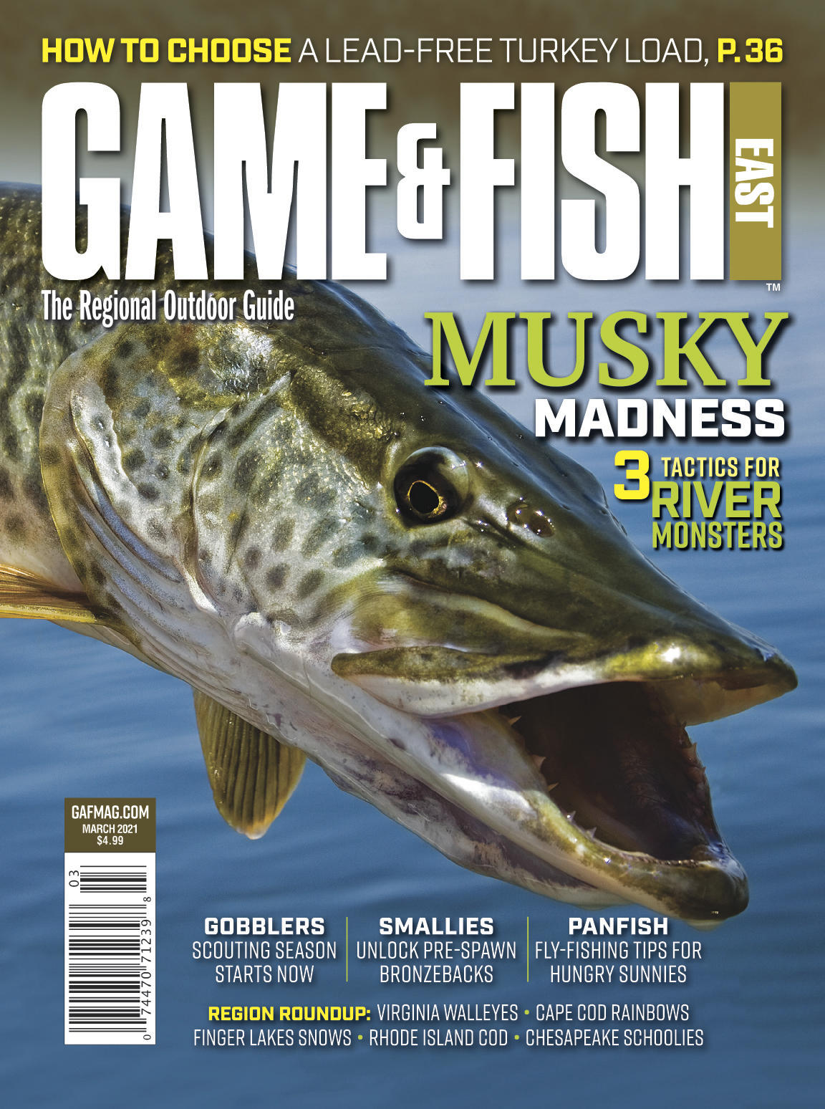
2022 | OSG KAYAK FISHING MULTIMEDIA GROWTH INITIATIVE
PRINT
A newsstand exclusive Special Interest Publication focusing 100% on kayak fishing targeted to new participants called: Kayak Fishing Fun – A Success Guide for New Kayak Anglers with a distribution of 80,000 copies on newsstands nationwide April 12, 2022. This is a premium format magazine with beautiful photography published on heavy paper stock and a large trim size retailing for $9.99.
A dedicated special kayak fishing section in our four subscription-based print magazines, In-Fisherman, Game & Fish, Fly Fisherman and Florida Sportsman magazines delivering an audience reach of over 6.5 million readers.*
*Source: Measured audience for these publications is collectively over 6.5 million readers based on 2021 Doublebase MRI for the measured magazines (In-Fisherman/Game & Fish) and June’21 AAM circulation multiplied by MRI prototype RPC for the non-measured magazines (Fly-Fisherman/Florida Sportsman).This research is utilized by every major consumer marketer from Chevy to Progressive Insurance to authenticate total audience reach.

Slide 5
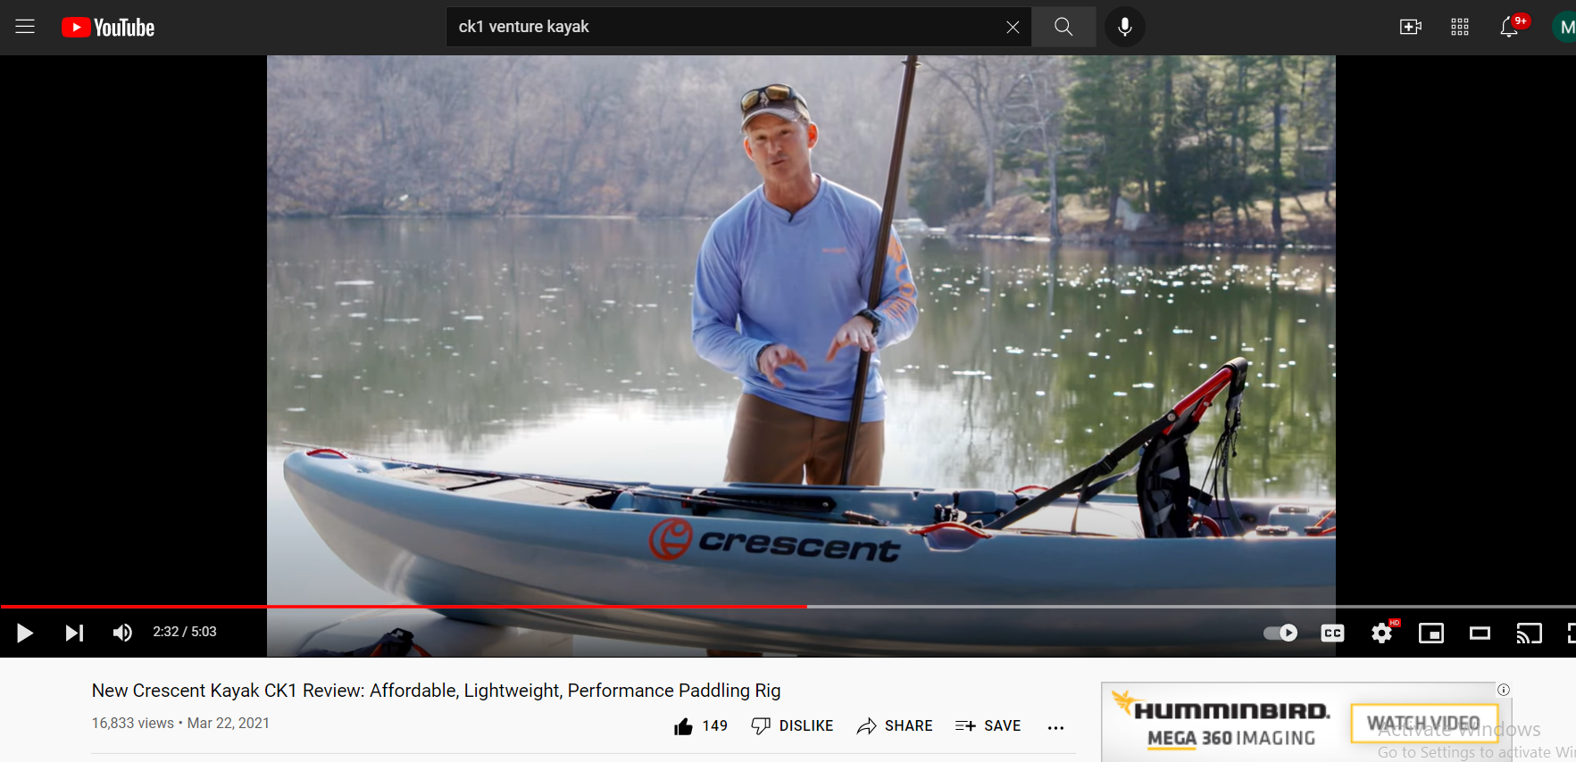
2022 | OSG KAYAK FISHING MULTIMEDIA GROWTH INITIATIVE
DIGITAL & SOCIAL
We will also be producing well over a dozen how-to videos for our branded websites and YouTube channels on everything from choosing the right kayak for your fishing needs and water-type to effectively rigging it for your specific fishing requirements. These videos will be released regularly throughout the year.
A total of 32 specific social media outlets (Facebook, Instagram, YouTube, Twitter for all eight OSG fishing outlets) will be publishing a regular series of informational posts and promotions for our multimedia efforts and TV special throughout the first half of the year.
A Success Guide For New Kayak Anglers
Need images from YouTube pages of reviews
Please contact your Outdoor Sportsman Group representative to review options for inclusion and participation.

Slide 6
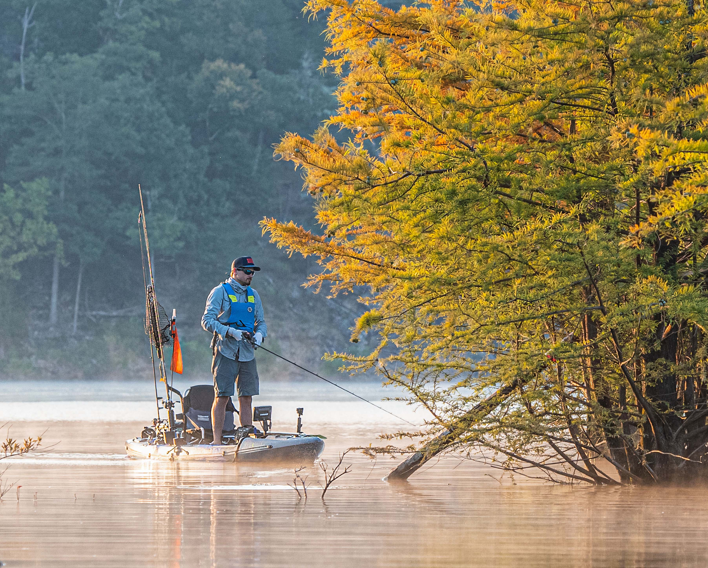
2022 MULTIMEDIA GROWTH & EDUCATION INITIATIVE UNPRECEDENTED SCALE & REACH
Outdoor Sportsman Group’s 2021 KAYAK FISHING FUN! delivered more total scale and reach than any consumer initiative ever launched in the kayak media universe:
15 combined airings across Outdoor Channel, World Fishing Network and Sprortsman Channel of the one-hour Kayak Fishing Fun! TV Special netted over 900,000 viewers!
Our combined social and digital posts delivered over 1,001,020 impressions!
Our eight-page Kayak Special Sections in Game & Fish, Florida Sportsman, Fly Fisherman, In-Fisherman magazines plus our Kayak Fishing Fun premium newsstand magazine influenced 7,995,625 total readers!
Total consumer impressions to date are 9,896,645 – and continuing to grow each day on our social and digital outlets!
2022 will be even larger – secure your spot today!
Please contact your Outdoor Sportsman Group representative to review options for inclusion and participation.

Slide 7
GOLD SPONSORSHIP PACKAGE - $19,950
In addition to the paid media outlined below, sponsorship also includes $25,000+ in added value co-branded elements.
(100x on-air promos, 50x on-air snipes – per network)
TELEVISION
4-5 minute product review segment (sponsor receives final cut for their own use)
Included in a combined 15 total airings on Outdoor Channel, Sportsman Channel, and World Fishing Network
Logo inclusion in two (:10) "brought to you by" billboards per airing
PRINT
Full-page ad in Kayak Fishing Fun special interest publication
Editorial inclusion in special kayak sections of Game & Fish, In-Fisherman, Florida Sportsman, Fly Fisherman
DIGITAL & SOCIAL
Product review segment placed across OSG’s four fishing websites and respective YouTube channels ROS Media
240,000 banner ad impressions on OSG fishing websites
Social – one organic post per brand - 8 brands (OC, OC+, SC, WFN, MOTV, Game & Fish, In-Fisherman, Florida Sportsman) driving to Kayak video
E-Newsletter inclusion in OC, SC, WFN and two additional brands (co-brand)
Video segment to be featured in dedicated section of MyOutdoorTV
Please contact your Outdoor Sportsman Group representative to review options for inclusion and participation.

Slide 8
SILVER SPONSORSHIP PACKAGE - $9,950
TELEVISION​
2-4 minute product review segment (sponsor receives final cut for their own use)
Included in a combined 15 total airings on Outdoor Channel, Sportsman Channel, and World Fishing Network
Logo inclusion in two (:10) "brought to you by" billboards per airing
PRINT
Half-page ad in Kayak Fishing Fun special interest publication
Editorial inclusion in special kayak sections of Game & Fish, In-Fisherman, Florida Sportsman, Fly Fisherman
DIGITAL & SOCIAL
Product review segment placed across OSG’s four branded fishing websites and respective YouTube channels.
Social – one organic post per brand - 8 brands (OC, OC+, SC, WFN, MOTV, Game & Fish, In-Fisherman, Florida Sportsman) driving to Kayak video​
Video segment to be featured in dedicated section of MyOutdoorTV
Please contact your Outdoor Sportsman Group representative to review options for inclusion and participation.

Slide 9
BRONZE SPONSORSHIP PACKAGE - $4,950
TELEVISION​
Product integrated and highlighted in body of program
Included in a combined 15 total airings on Outdoor Channel, Sportsman Channel, and World Fishing Network
Logo inclusion in two (:10) "brought to you by" billboards per airing
PRINT
1/3-page ad in Kayak Fishing Fun special interest publication
Editorial inclusion in special kayak sections of Game & Fish, In-Fisherman, Florida Sportsman, Fly Fisherman
DIGITAL & SOCIAL
Product review segment placed across OSG’s four branded fishing websites and respective YouTube channels.
Social – one organic post per brand - 8 brands (OC, OC+, SC, WFN, MOTV, Game & Fish, In-Fisherman, Florida Sportsman) driving to Kayak video​
Video segment to be featured in dedicated section of MyOutdoorTV
Please contact your Outdoor Sportsman Group representative to review options for inclusion and participation.

Slide 10
KAYAK FISHING FUN – PUBLICATION ONLY
Full page - $3000
1/2 page - $2200
1/3 page - $1750
Inside Front Cover - $4550
Inside Back Cover - $4500
Outside Back Cover - $4750
Ad Close – 3/1/22
On Sale Date – 4/12/22
Please contact your Outdoor Sportsman Group representative to review options for inclusion and participation.

Slide 11
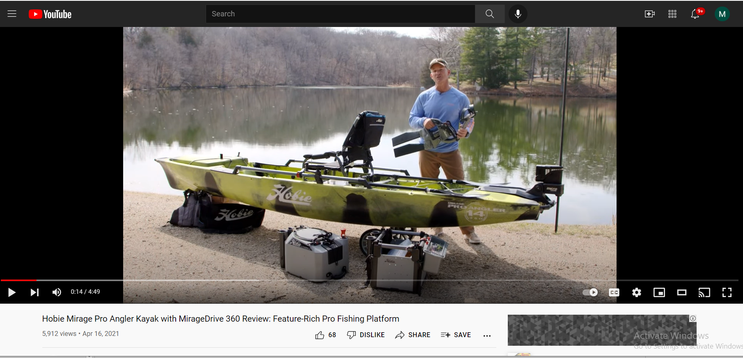
2022 | OSG KAYAK FISHING MULTIMEDIA GROWTH INITIATIVE
DIGITAL & SOCIAL
We will also be producing well over a dozen how-to videos for our branded websites and YouTube channels on everything from choosing the right kayak for your fishing needs and water-type to effectively rigging it for your specific fishing requirements. These videos will be released regularly throughout the year.
A total of 32 specific social media outlets (Facebook, Instagram, YouTube, Twitter for all eight OSG fishing outlets) will be publishing a regular series of informational posts and promotions for our multimedia efforts and TV special throughout the first half of the year.
A Success Guide For New Kayak Anglers
Need images from YouTube pages of reviews
Please contact your Outdoor Sportsman Group representative to review options for inclusion and participation.

Slide 12
NEED NEW IMAGE
2022 MULTIMEDIA GROWTH & EDUCATION INITIATIVE
Outdoor Sportsman Group’s KAYAK FISHING FUN multimedia initiative will launch Season 2 in April of 2022. Our goal with this year’s program is to maintain the demand created in 2021 of new buyers, and to educate and teach new kayak and canoe owners how to get the most out of their hull investment through smart and creative rigging and outfitting. After helping consumers find their perfect kayak, we will be educating all the recent buyers of kayaks and canoes on how to operate and rig their boats for optimal performance, safety and success on the water. To inform this new audience of prospects, we will be utilizing every media asset we own.
A Lot of future sales have been pulled forward into 2021 – this comprehensive program will help maintain growth of new participants in 2022 and beyond, and we look forward to helping you grow your brand’s market share with it!
Please contact your Outdoor Sportsman Group representative to review options for inclusion and participation.

